Slide 1
National Women’s Health
Annual Clinical Report 2018
Gynaecology Critique
Dr Robert Sherwin MA, PhD, FRCOG
Consultant Obstetrician and Gynaecologist,
Subspecialist in Urogynaecology
Director of Women’s Health ADHB

Slide 2
Benign Gynaecology
Abortion services
In-patient surgery Urogynaecology
General Gynaecology
Laparoscopic Surgery
Fertility

Slide 3

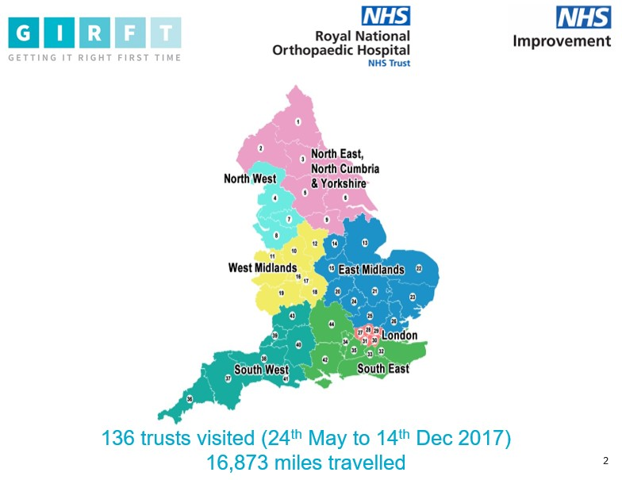
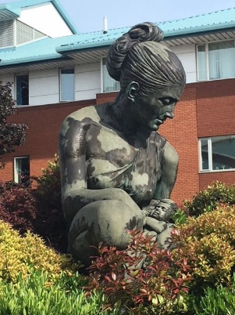
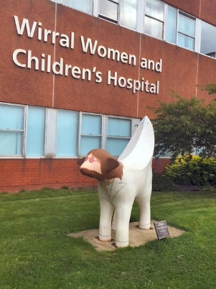
‘Getting it Right First Time’- O&G
Methodology for all 32 disciplines
Share benchmarked data
Clinical discussion of data and sharing
Departments produce action plan
Implementation teams meet with CEO,
CMO and clinical leads to review progress
National report
Revisit

Slide 4
The Data- what is missing?
Coding data v registry data v theatre data. Should we risk adjust?
Self Management Outcome for women accessing on-line self management
Primary care data: Mirena Coil insertion in community per 1000 women/ pa
Referrals to secondary care per 1000 women/pa
Secondary care: Patient experience in GOPD and IP
(NWH 16%; England Median: 23.78%: range 54% to 0.87%)
PROM for patients treated in GOPD or post surgery
Outpatient procedure, day case and GSU outcomes data
Tertiary care: Survival data
Incident and safety
Whole Patient Pathway

Slide 5
Surgeon Level Data- NCIP (NHSi)
National Clinical Improvement Programme (NCIP)
In-patient surgery General Gynae and Endometriosis Urogynaecology
Urology
Gynae- Oncology
Coding data, results delivered through digital portal
Pilots underway in 5 hospitals; aim to support improvement

Slide 6
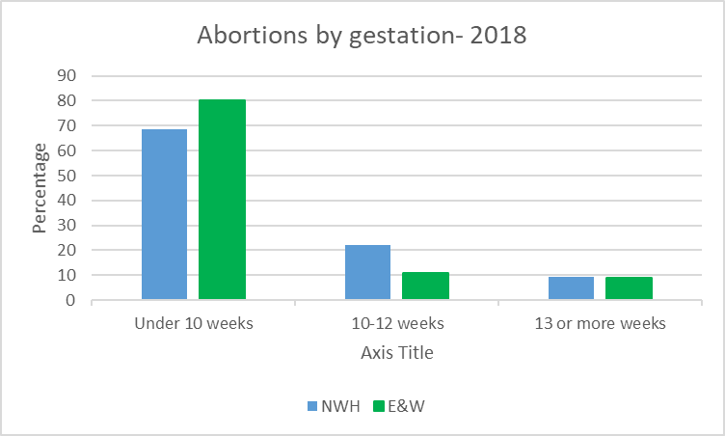
Abortion Care
Abortion rates NZ 2008: 21.1 to 2018: 13.7 per 1000 women 15-44yr (NWH 2008: 5550 2018: 3645)
E&W 2018: 17.4 per 1000 (increase from 2017)
Medical Abortion NWH Early Medical Abortion (<9 weeks gestation) 28%
‘Young Maori and Pacific women less likely to access medical abortions’
E&W 2018– 71% medically induced but 1st/2nd Trimester data

Slide 7
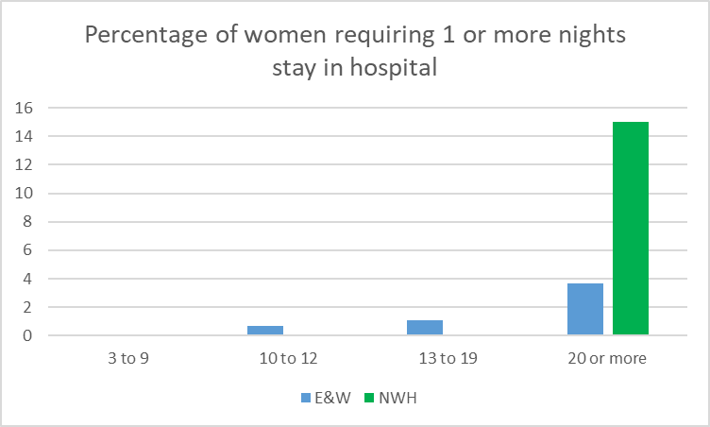
Abortion Care
Hospital stay for 2nd Trimester Abortions: ‘85% of women were managed as either a day stay or required one night in hospital in 2018. The aim is to run this service as a day stay’

Slide 8
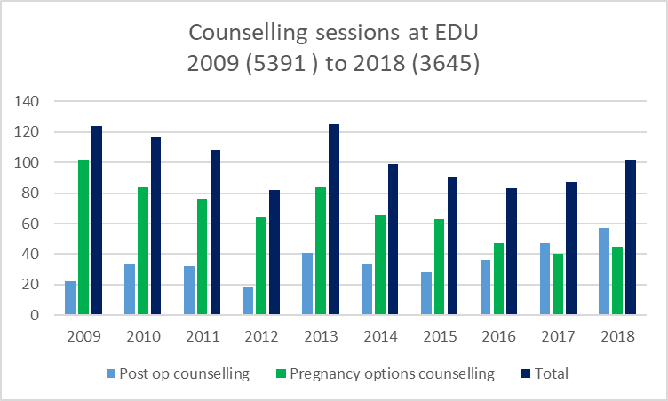
Abortion Care
Complications: E&W Reported in 1 in 597 abortions /NWH Audit planned for EMA
Chlamydia Screening E&W 2018: 90% for all women, 96% for under 20yr olds / NWH
Counselling Consistent workload and low % declines
Law Reform
LARC delivery

Slide 9
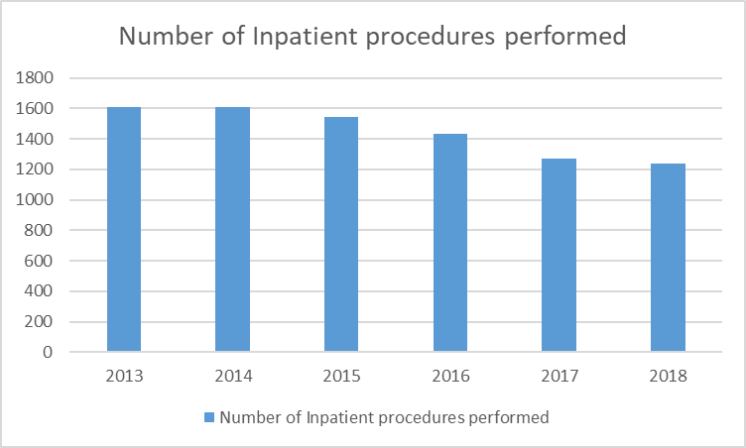
General Gynaecology
NWH New to Follow-up ratio = 0.96 (4090 New : 3920 F’up)
(GIRFT Median 1.11; Lowest N:F/up ratios 0.50)
Data does not include GSU or EDU data
(difficult to compare with GIRFT data)

Slide 10
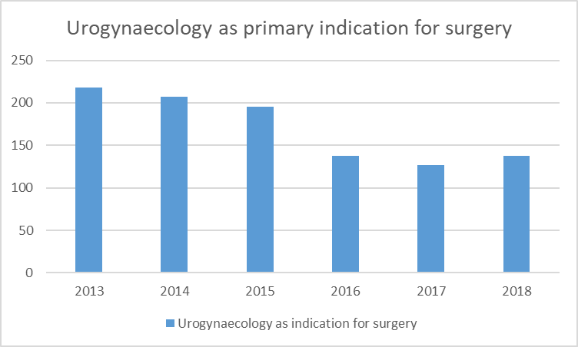
Urogynaecology
In 2018: 135 primary inpatient procedures 35 tension-free vaginal tape repairs (TVT)
14 sacrocolpopexy
83 prolapse repairs (21 with vaginal hysterectomy)
35 other urogynaecology procedures.
Some women, two or more urogynaecology procedures
58% patients overweight / obese
Q) Are all procedures recorded on UGSA database / National Registry?
Q) How do PROM outcomes benchmark?
Q) How do complications benchmark?
Q) Are all surgeons completing enough volumes?

Slide 11
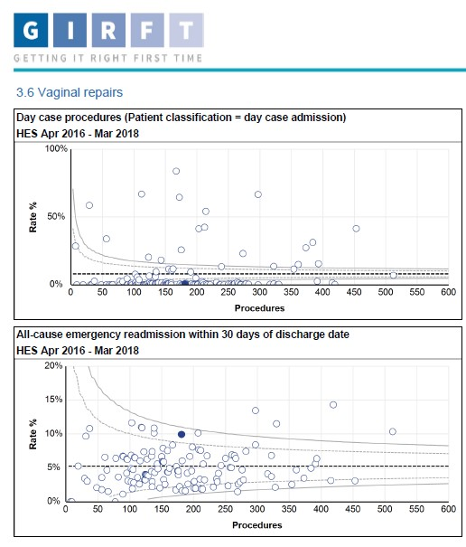
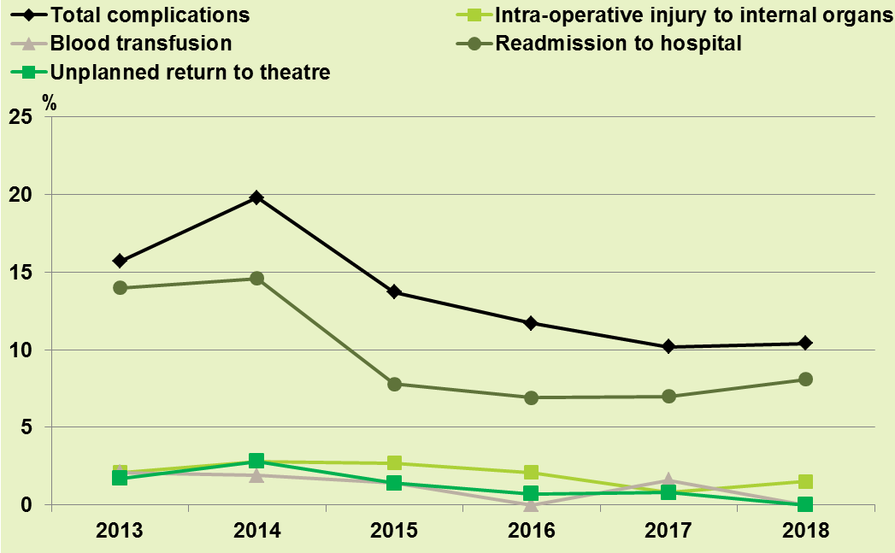
Urogynaecology- repairs
In 2018: 14 sacrocolpopexy
83 prolapse repairs (21 with vaginal hysterectomy)
Complications: 10% (Inadvertent cystotomy & trocar injury)
Readmissions- 11 (7.5%)

Slide 12
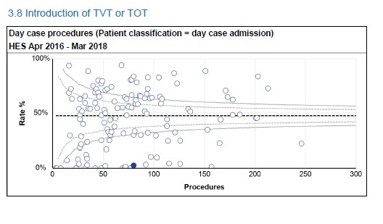
Urogynaecology
Audit of NWH mid-urethral sling Sept 2015-Sept 2018- (internet)
131 retropubic TVTs placed
11 lost to follow up,
71 (59%) had TVT performed alone.
35 (16%) with prolapse repair
4 subspecialists performing procedures (NICE; no longer include volume per surgeon)

Slide 13
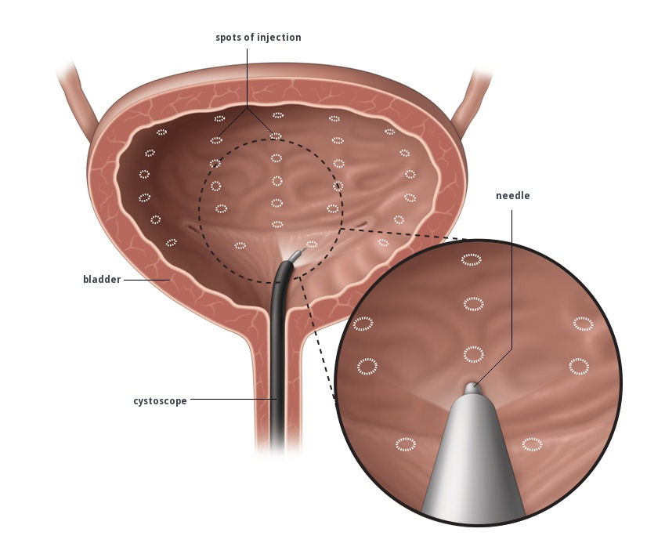
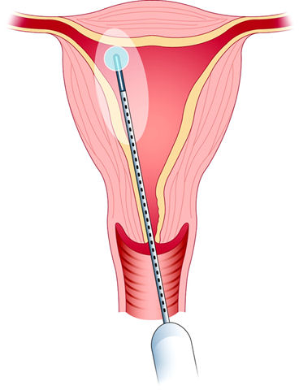
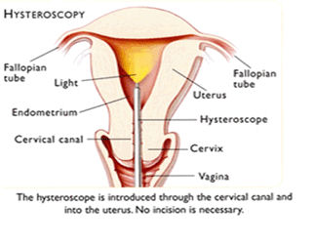
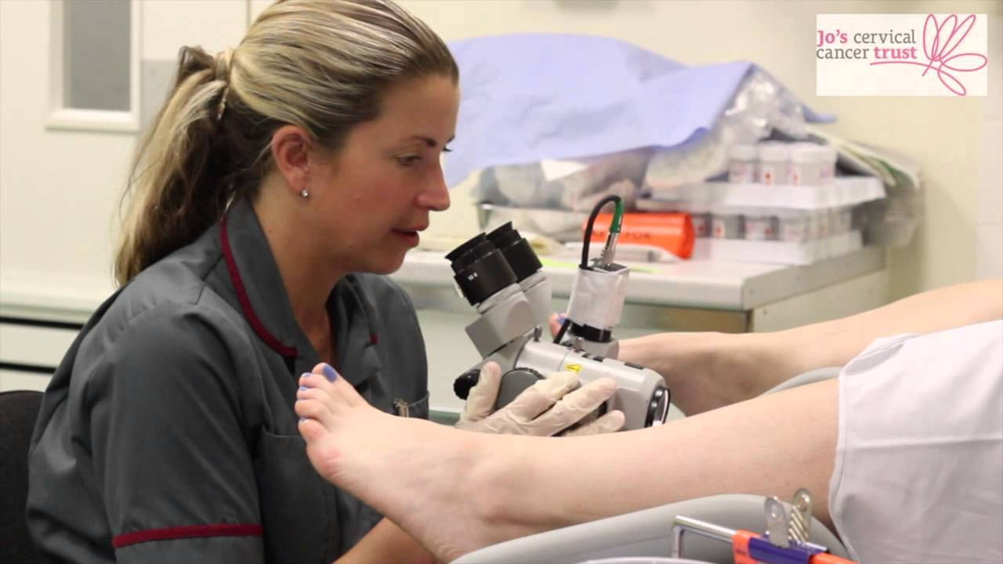
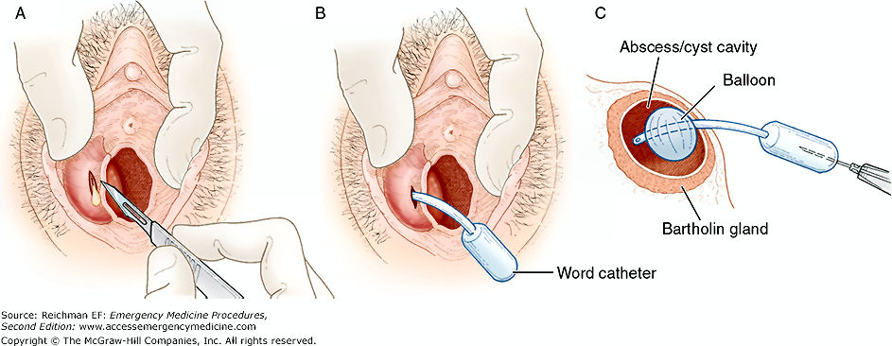
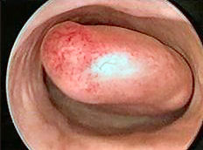
Benign Gynaecology: Outpatient procedures
Cystoscopy & Botox: 100%
Hysteroscopy +/- polyp 94%
(NWH 143 IP Hysteroscopies)
Bartholin’s abscess 64%,
Colposcopy treatments 99%,
Outpatient ablation: 74%,
Many performed by nurses
Cystoscopy & Botox Endometrial ablation Hysteroscopy
& Polypectomy
Colposcopy treatments Words Catheter Hysteroscopy & Polypectomy

Slide 14
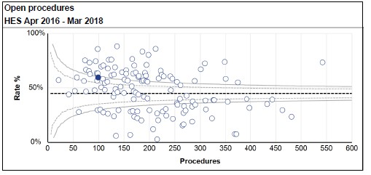
Hysterectomy- General Gynaecology
Are the operations indicated?
Do women get a choice of route of surgery, appropriate to their condition?
Are surgeons performing sufficient numbers of operations?
National Women’s Health GIRFT (England)
Endometrial Cancer 35.6% laparotomy n=50pa
Benign hysterectomy <50yr ~45% n=100pa

Slide 15
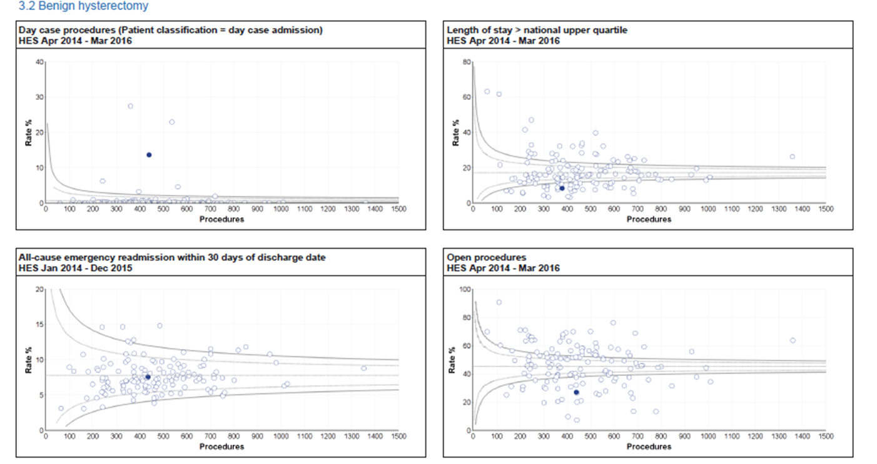
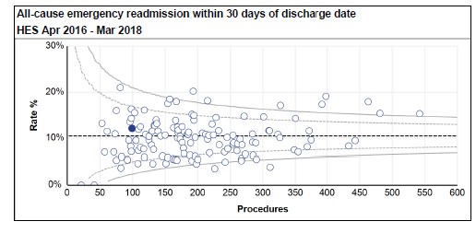
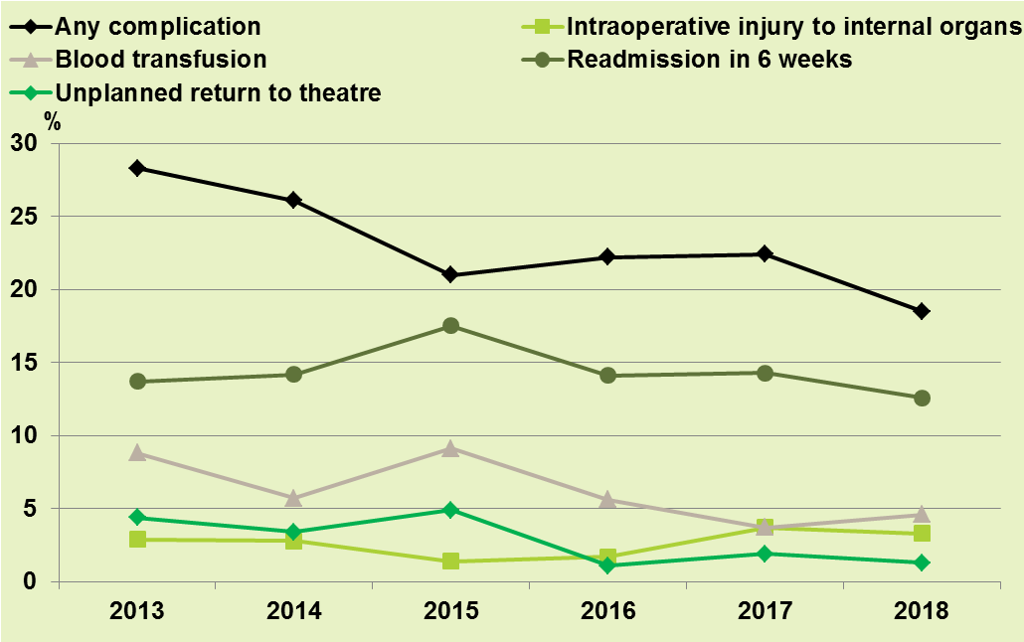
Hysterectomies- General Gynaecology
Day case hysterectomies
Book on day case pathway,
Set patient expectation in clinic,
Enhanced recovery,
Team approach
Volunteers stay overnight
NWH 2018-Readmissions 12.5%
ERAS project / 0% VTE

Slide 16
Hysterectomies- General Gynaecology
LENGTH OF STAY (days) Median(IQR) England (Median)
All hysterectomies 2 (2-3) 2
Abdominal 3 (3-4) 3
Laparoscopic 2 (1-2) 1
Vaginal 2 (2-2.5) 2

Slide 17
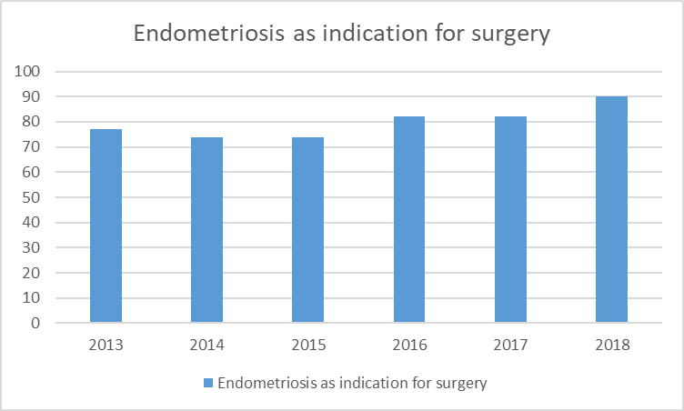
Laparoscopic Surgery n=373
ANY COMPLICATION 46 12.3%
Blood transfusion 8 2.1%
Intra operative injury 0
Failure to complete procedure 0
Anaesthetic complications 2 0.5%
Significant post-operative infection 0
Unplanned return to theatre 2 0.5%
Admission to DCCM 1 0.3%
Readmission to hospital 34 9.1%
Post op complications 29 7.8%
Planned readmission 0 0
Other 5 1.3%

Slide 18
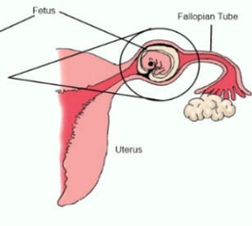
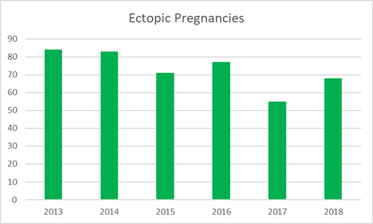
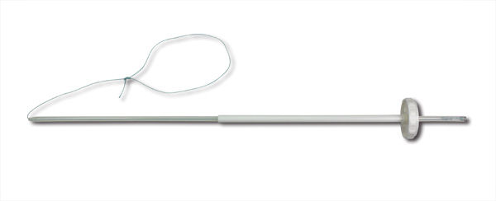
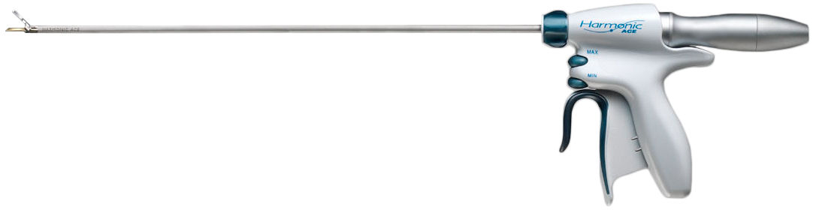
Consumables
1) Use of national procurement website to compare costs
Display costs (laminated sheet in scrub area)
2) Choose equivalent equipment but more cost-effective
3) Agree use of consumables for specific procedure
£15
£450

Slide 19
Fertility PLUS
Stopped Cycle rate =9% (ANZARD <10%)
(32/47 poor ovarian response, 7/47 over response, 8/47 other);
Oocyte pick up =91%
Embryo Transfers =61% (ANZARD 52%)
Freeze All- (25 P4 >6nmol/L, 20 risk OHSS, 39 agonist trigger use, 5 endometrial polyps detected, 4 no eggs collected, 20 no fert)
Severe OHSS requiring hospitalisation 0.4% (2 patients)

Slide 20
Fertility PLUS
Cumulative live birth rate at 12 months per egg collection
(Jan 2015-16)= 35%
Multiple pregnancy rate 1.5% (comparable to spontaneous rate)
IUI; live birth rate 12.1% / DI 8.6%
Demographics PVDW review 2013 ‘“We are aware Maori women are underrepresented in IVF/ICSI treatment cycles”

Slide 21
Summary
Many areas of excellence
Collect PREM and PROM data from whole patient pathway
Be responsive to the needs of our patients, especially in terms of access
Support our staff and develop nursing roles
Aim high

Slide 22


