Slide 1
Review of neonatal care in New Zealand (2012-2017)
Nicola Austin
Chair, Newborn Network,
NZCYCN, 2019

Slide 2
Background for the review
Newborn network was set up in 2013.
The aim of the New Zealand Child & Youth Clinical Network (NZCYCN) newborn network is to provide clinical leadership in the development and maintenance of a sustainable nation-wide, clinical service for newborns as close to home as is practicable.
Clinical reference group, 6-8 weekly zoom meetings, 1-2 face to face meetings.

Slide 3
The clinical network will:
,
advocate for the provision of equitable high quality newborn care in New Zealand
foster and refine the system for the provision of a nationally coordinated newborn continuum of care
consider transport requirements
inform service planning and service specification (MoH) review

Slide 4
The review
Problem Definition
Neonatal units in New Zealand have been under sustained pressure for several years with rising levels of occupancy to levels which are becoming more difficult to manage.
Higher levels of occupancy can lead to more staff and parent stress, increased risk of nosocomial infections and increased rates of clinical error. The units are currently maintaining high quality outcomes.
A review of current pressures, responses and possible short and medium-term responses is required.

Slide 5
The scope
complete an updated literature review on neonatal cot occupancy and drivers of increased demand
analyse the cot occupancy at all NICUs in New Zealand, and review under the regional hub and spoke model
investigate the causes of the current high occupancy in neonatal units, including changing patterns of care
identify any immediate and medium actions which could be taken, at any level, to ensure continued safe and effective quality services in neonatal units. This may include, but is not limited to, improved regional co-ordination and identification of models of care
include modelling the number of staffed cots for their local and regional population and advising on adequate nursing, medical, allied health staff and resources to provide safe and effective services
advise on a potential sustainable services plan with short and long term recommendations; i.e. forecasting additional capacity requirements, quality improvement projects
recommend options for governance, either national and/or regional for neonatal units
identify if neonatal transport can be incorporated into the inter-DHB transport services.

Slide 6
Process
Tender…… contract
Malatest
Interviewed the Review committee
Survey of staff across the country
Data review 2012-2017 through MOH

Slide 7
Factors driving demand
Unavoidable
Low gestational age babies – (ethical issues over lower threshold)
Improved technology and neonatal practices – may be more staff intensive
Potentially modifiable but outside NICU control
Population health – BMI, gestational diabetes, substance abuse and withdrawal, poverty
Older maternal age
Rates of multiple births
IVF, fetal medicine
Potentially modifiable by MoH/DHBs
NICU staffing levels
Public health and addictions care
Obstetric practices – early induction, pressure from parents for early delivery
Notes:
The highest proportions of women with BMI of 30 or over live in Northland, Counties Manukau, Lakes, Tairāwhiti, Whanganui, Wairarapa and South Canterbury DHBs.
The highest proportions of women with very low BMI (less than 18.5) live in Waitemata, Auckland and Nelson Marlborough DHBs.
Duncanson M, Oben G, Adams J, Wicken A, Morris S, Richardson G. and McGee MA Draft. The early years: Draft report for New Zealand Aotearoa 2017. Dunedin: New Zealand Child and Youth Epidemiology Service, University of Otago.

Slide 8
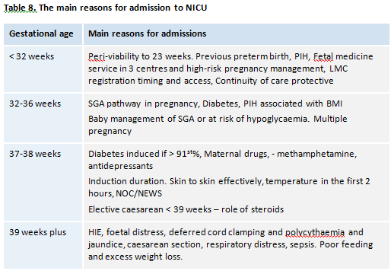

Slide 9
Equity – deprivation quintiles of mothers
Māori under represented in L3 (22% compared to 34% and 37% for L2 and L2A respectively.
Does this reflect lower levels of need or location of L3 units?
OR
Reflects geography and ethnicity of L2 and L2A units DHB’s
Birth at higher GA 32 weeks + stay at the level 2 and 2 A units.
Higher late preterm associated with Low deprivation, higher smoking rates

Slide 10
Service Specification review 2018/19
Define intensive care into two categories
Full intensive care
High dependency intensive care
Special care – other than respiratory support
Transitional care – presence of mother
Neonatal outreach role

Slide 11
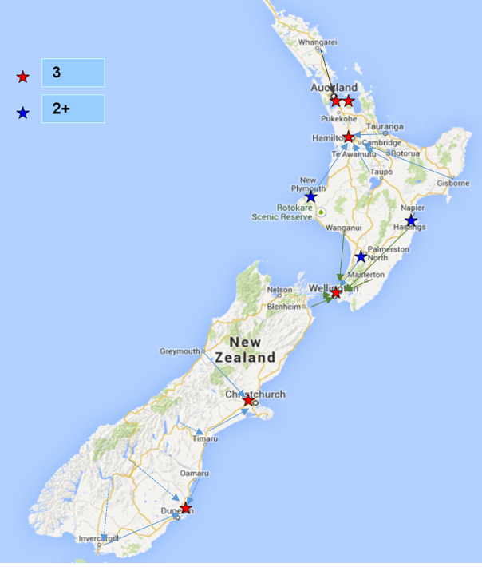
2
2-

Slide 12
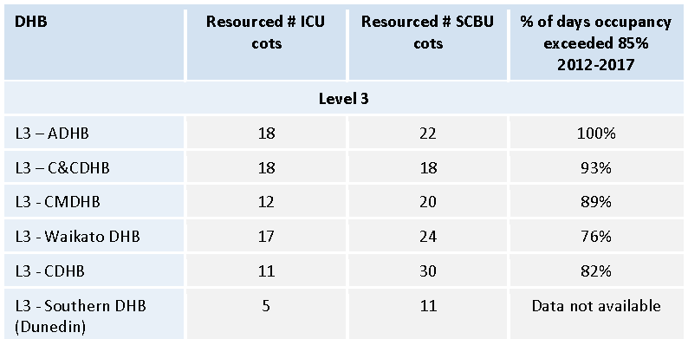
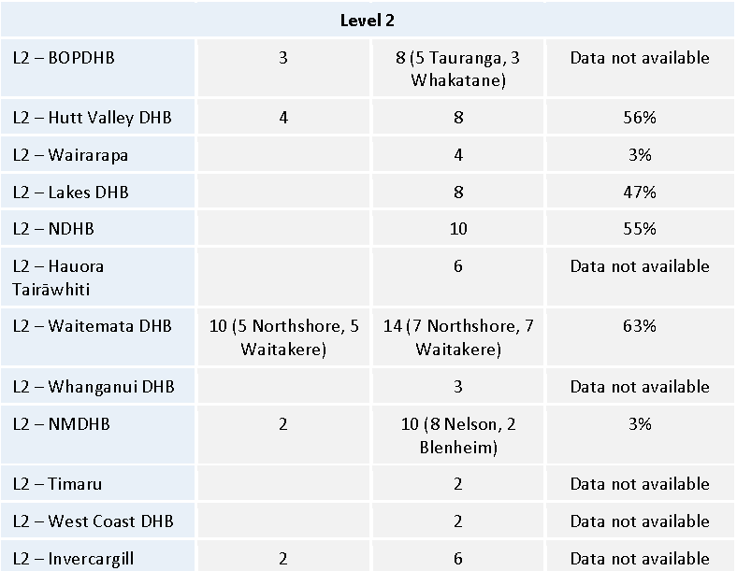
Resourced cots

Slide 13
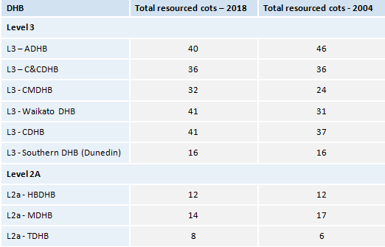
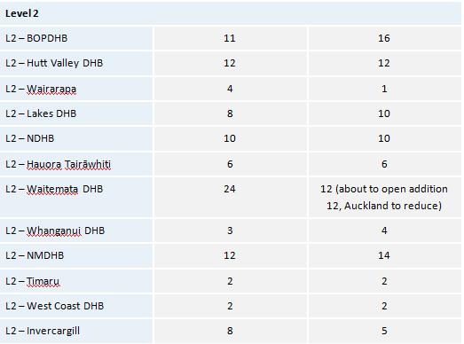
Cot numbers 2018 : 2004
Total 2004 2018
319 342 A 7.2% increase in 3 L3 units: CMDHB , Waikato , CDHB
2 Level 2 units have increase by 8 cots, some have less.

Slide 14
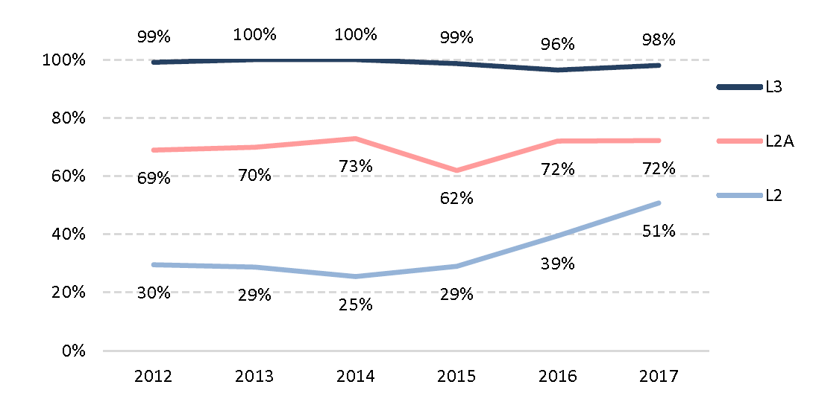
2012-2017 Occupancy > 85%

Slide 15
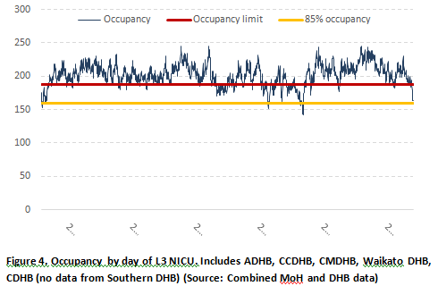
Level 3 UNITS

Slide 16
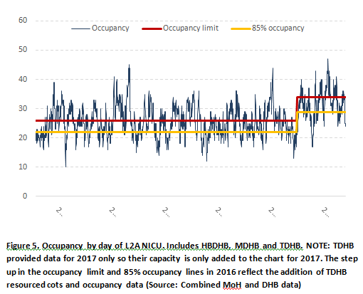
2A UNITS

Slide 17
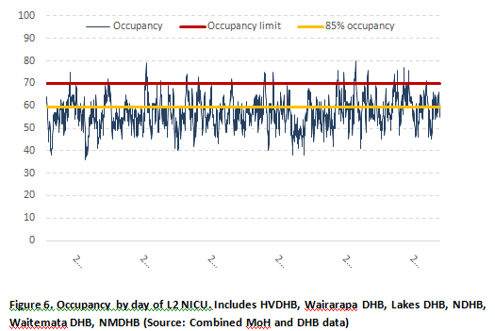
Level 2 UNITS

Slide 18
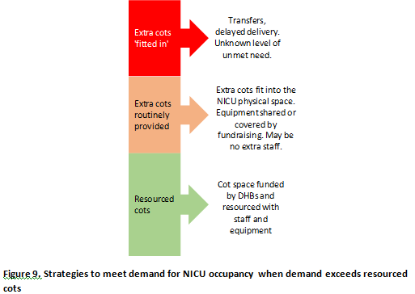

Slide 19
System issues
Information shortages limit monitoring – there is no national data set that allows effective monitoring of neonatal intensive care and tracks cot numbers and resourcing. National and local leadership – has the potential to drive sector development if adequately resourced National cot status – a national website was often described as inaccurate because it was not kept up to date. Managers spent considerable time phoning around to find cot space. Stakeholders also described overcrowding as influencing decisions to transfer or accept transferred babies. Information sharing – IT systems that restrict information sharing result in inefficiencies and duplication of tests. Lack of interface with other agencies, especially Oranga Tamariki can extend the length of stay in neonatal intensive care for babies who do not have safe warm home to go to. Shortages of social workers compound these challenges.

Slide 20
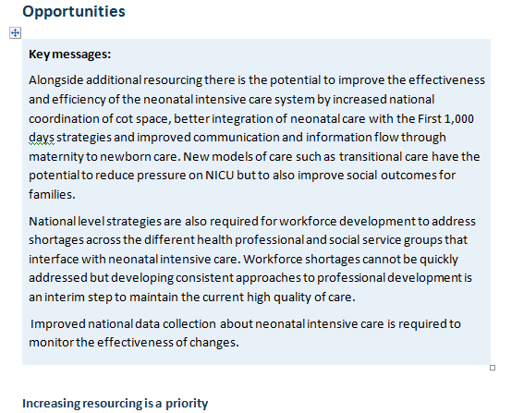

Slide 21
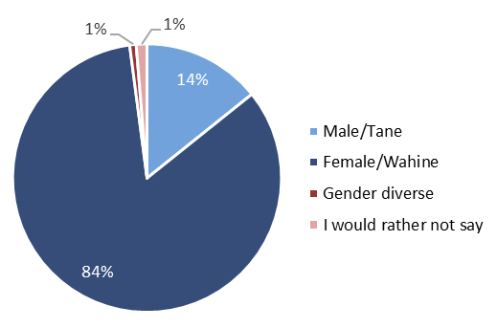
Workforce profile
Many of the nursing staff are long term neonatal nurses >20years. I am concerned about succession planning [as I have] limited ability to employ nursing staff with the capacity to train them adequately as they are rostered 1 of 2 staff / time is limited. (Survey – manager)

Slide 22
Agreement that quality care is provided
We are all very dedicated to our craft and believe we offer exceptional service but are under enormous stress constantly with substandard equipment or no equipment and expectations of delivery suite and postnatal services. (Survey – registered nurse)
On the days when it is very busy and we are stretched to full capacity, it is harder to do more than adequate work. This is unfair on the patients and their families. It also means I go home feeling stink about the work I did. (Survey – other)

Slide 23
Workforce development
No standard approach to workforce development, no national standardised education programme for NICU nurses
29% strongly/disagreed they had adequate opportunities for education and training
22% strongly/disagreed they could get study leave
25% unable to get annual leave when requested
Study days cancelled due to lack of staff on the floor. Not many down time days as work loads are heavy due to lack of space and staff. (Survey – registered nurse)
I believe ongoing education should be improved. There are excellent postgraduate neonatal nursing papers available however once you have done them, there is nothing to maintain your knowledge. (Survey – registered nurse)

Slide 24
Workforce shortages
Proportion who consider a shortage of a professional group is always or often a problem
Role | L3 | L2A | L2
Specialist paediatric/ neonatal staff | 47% | 36% | 19%
Neonatal trained nurses | 62% | 36% | 39%
Midwives on the postnatal ward | 77% | 58% | 53%
Lactation consultants | 54% | 35% | 27%
Outreach neonatal trained nurses | 33% | 33% | 25%
Social workers | 40% | 28% | 31%

Slide 25
Workforce overview

Slide 26
Only CMDHB and Blenheim have recognised TC beds.
All Postnatal wards have babies on them needing more than well newborn care, which is not currently “counted”.
More babies from 35 weeks could be cared for with mother present if staffed for their clinical needs.
LOS likely 4-14 days

Slide 27
Communication and interfaces
The proportion who consider the following are always/ often a problem
 | L3 | L2A | L2
Capacity in the birthing units for acute transfers | 40% | 23% | 19%
Capacity in maternity for antenatal transfers needing inpatient care | 39% | 27% | 15%
SCBU capacity to take babies from L3 units (back transfers) | 67% | 34% | 34%
Once nurse managers have established good communication with staff and got to know them it improves. Knowing who to talk to about transfers. I feel that Level III units don’t really understand the issues facing those in Level II and also the primary maternity units. Transfers from our primary birthing unit to our SCBU is very unsafe and problematic at times. (Survey – nurse/midwifery educator)

Slide 28
Transfers
The transfer of babies to another location disadvantages people who live in rural locations and may disproportionately affect families with lower incomes. Although the cost of the transfer and accommodation is funded from the public purse there are personal economic and social costs that include:
Travel for partners and whānau that are not included
Time from work that may not be paid for by employers
Lack of whānau support
Separation from other children
The potential for separation from the baby when transport for the mother is not immediately available that may affect parenting.
Transfer out puts huge stress on families…Uncertainty about location adds to that …Then having space to take them back. We are usually limited by nursing resources. (Interview)

Slide 29
Babies cared for elsewhere
12-14% of neonates cared for in a DHB other than their home DHB

Slide 30
Impact of periviability consensus
20-27 weeks 0.5% of all live births
0.2% at 23/24 weeks, 0.3% at 25/26/27 weeks PMMRC
Small increase in births at 23 weeks
2014 – 16, total ANZNN 56
13 alive at 3 days, 5 data to 36 weeks
At 23/24 weeks 2014 PMMRC
31 TOP, 28 Stillborn, 39 NND, 38 survivors Total 136
2016/7 ANZNN 95/100 admitted, 53.7% survival
NZ proportion likely 13-17
14/14/10 2015/6/7 admitted to NICU’s at < 24 weeks

Slide 31
Next Steps
National Neonatal Service Plan
Cot distribution
Regionally
National requirements
Outlier monitoring
Transitional Care
Business case for Budget resource allocation

Slide 32
Risks of status quo
No room for projected population growth
Unable to address communities with highest population growth, higher fertility in Maori and PI area
Avoidable deaths or morbidity when delivery delayed due to insufficient cots
Staff burnout, high staff turnover, lack of nurses with intensive care skills to care for high acuity cases.
Doing nothing resulting in no available cots in NZ – where do they go?

Slide 33
Strategies – short term
1) Reduce LOS on NICU through earlier discharge.
Through Family integrated care
More breast feeding support – Lactation Consultant FTE
Requires more discharge facilitation and neonatal home care resource – outreach nurses
Potential Consequences
Higher readmission to Paediatrics for Jaundice, dehydration, hypoglycaemia, poor feeding
Lower breast feeding rates
Social challenges not identified resulting in care and protection issues post discharge.

Slide 34
Strategies – short term
2) Transitional care model on the postnatal ward
Neonatal nursing care in conjunction with midwifery
Lactation consultant / breast feeding support
Social Work and allied health from NICU
Increased LOS on PN impacting on mother/baby bed requirements.
Space limitations possible
EOI for project manager closes 16th September
Proposed meeting October /November

Slide 35
Strategy- regional cot distribution
4 regions – Northern and Southern with 2 level 3 units
Increase in level 2 plus units caring for 28 weeks and above eg. Tauranga, Nelson, ?Waitemata DHB
Increase in level 2 cots, include cross DHB boundary arrangements. Eg Timaru have Ashburton 34+ week low risk deliveries.

Slide 36
Doing nothing isn’t an option
Maternal fetal medicine network review
Maternity service review
Preterm Birth Action Planning meeting 30th August.
Strategies to achieve optimum timing of delivery to minimise risk and optimise outcome for both mother and baby.

