Slide 1
ACR National Women’s Health Past, present, and future…… (the edited highlights)
Jason Waugh
Service Clinical Director: Regional Maternity Services
Associate Professor: University of Auckland

Slide 2
The Annual Clinical Report.
What to talk about ?
Why me ?
Where shall I start :
Why is NWH unique ?
Who do we benchmark ourselves against ?
What is MOST important to us going forward ?
What can we expect in the next ACR ?

Slide 3
Acknowledgements
The ACR is a phenomenal resource !!
Congratulations to all who contributed but especially :
Marjet Pot
Lynn Sadler
Nancy Li
Emily Clark

Slide 4
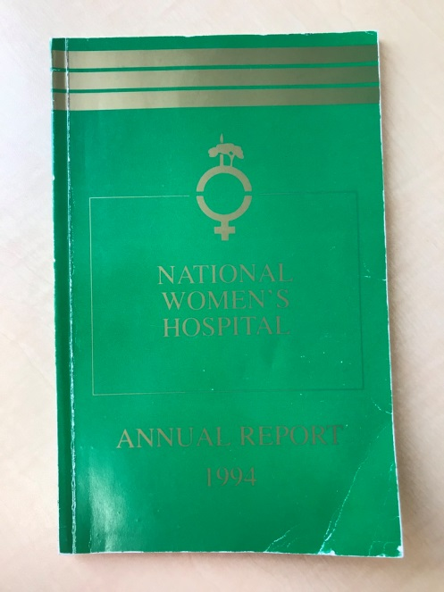
What shall we compare ourselves to ?
Locally – changes over time
2006-2018
Previous data is in a different format
Nationally – NZ data MoH
NZ maternity indicators are from 2017 but still relevant
Internationally – UK; Australia; US…………
RCOG data from 2014-2015 – uses similar metrics

Slide 5
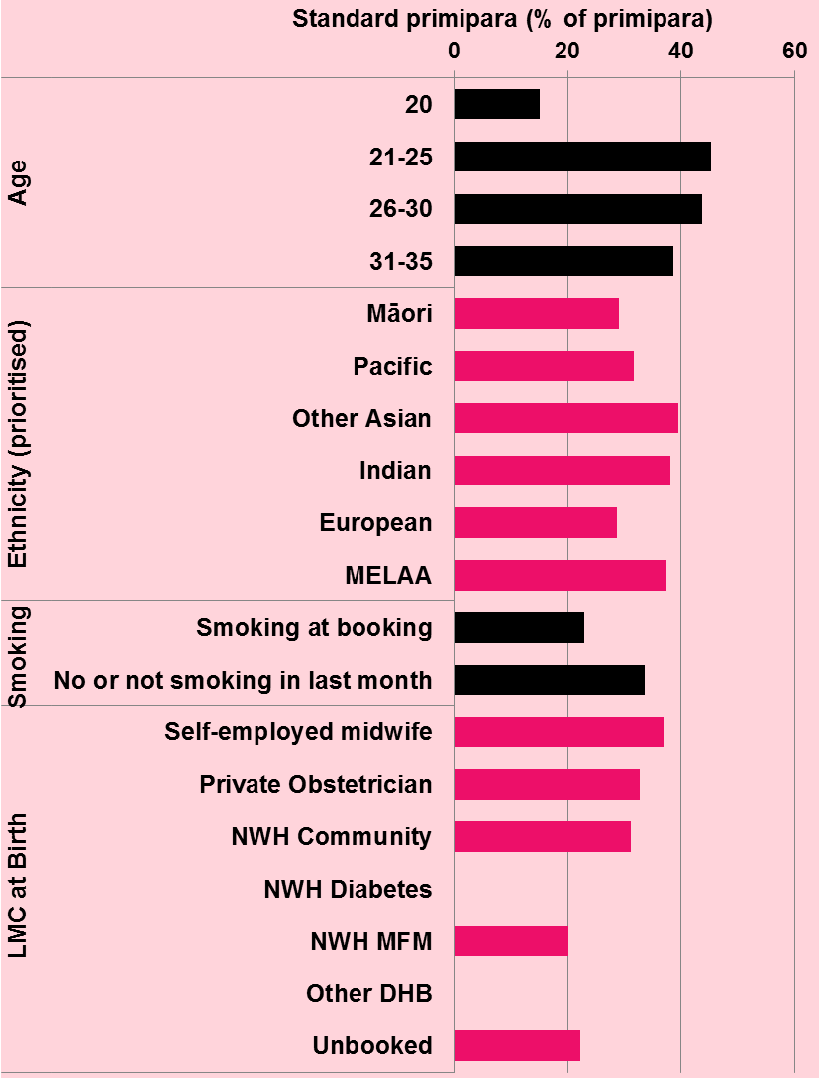
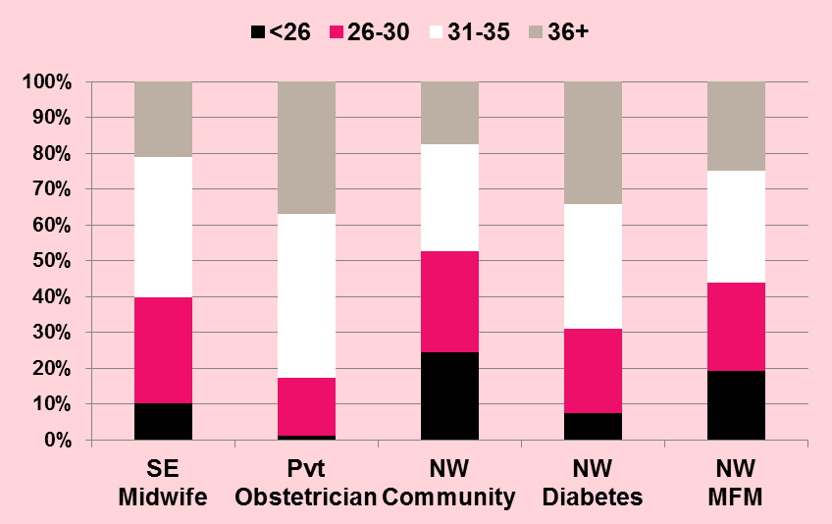
The Unique LMC mix
43% MW LMC
30% Private Obstetrician
20% NWH Comm Teams
7% NWH MFM

Slide 6
1994 – a different time.
9000 births
3000 public
2500 GP
IDMW
Private Obs’
1000 High Risk

Slide 7
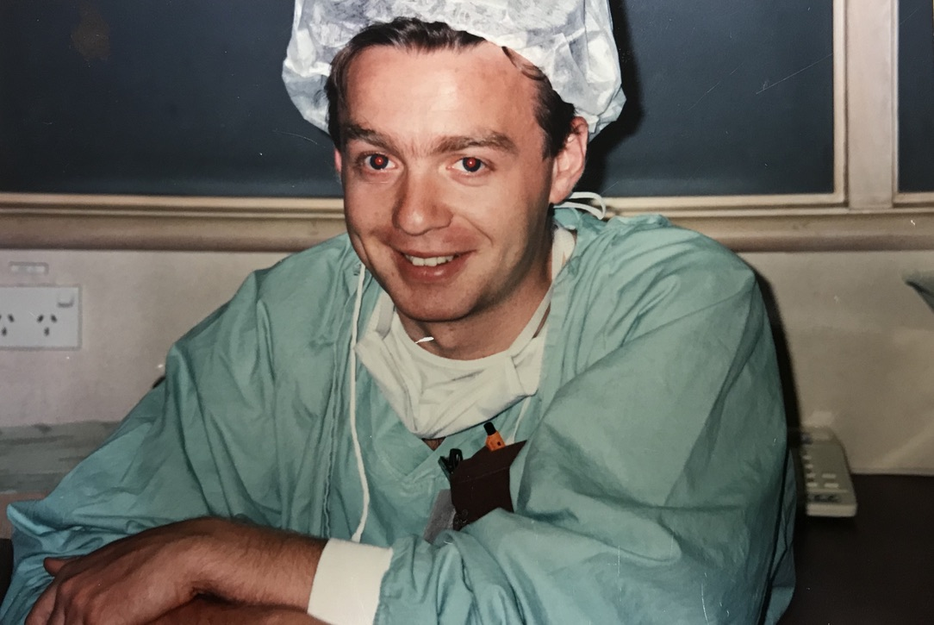
Not aged well !!

Slide 8
What do we do ?
The women we care for.
The Service
The end results

Slide 9
The women we care for.
Table 1: Mother and baby numbers: NWH 2018
Total number of mothers birthing at NWH | 6448
Mothers birthing before arrival (BBA) | 33
Total number of mothers | 6481
Total number of babies born at NWH | 6564
Babies born before arrival (BBA) | 33
Total number of babies | 6597
Twins 114 pairs

Slide 10
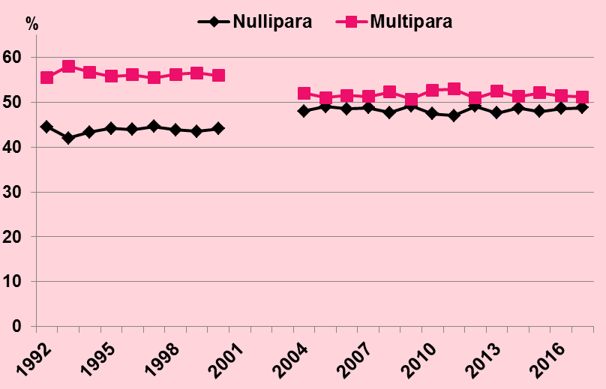
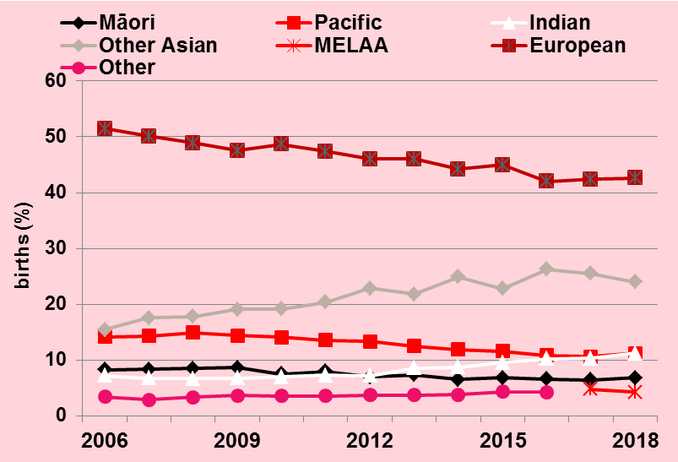
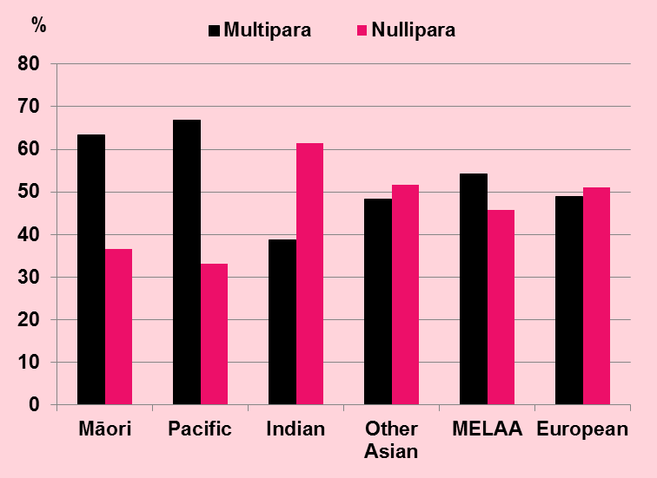
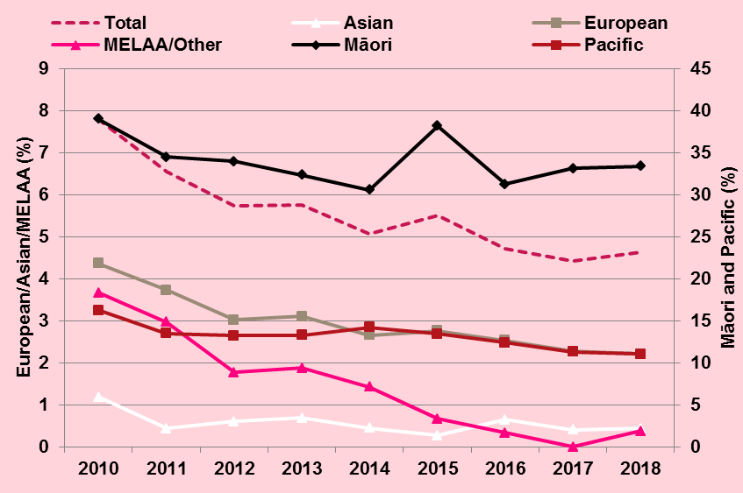
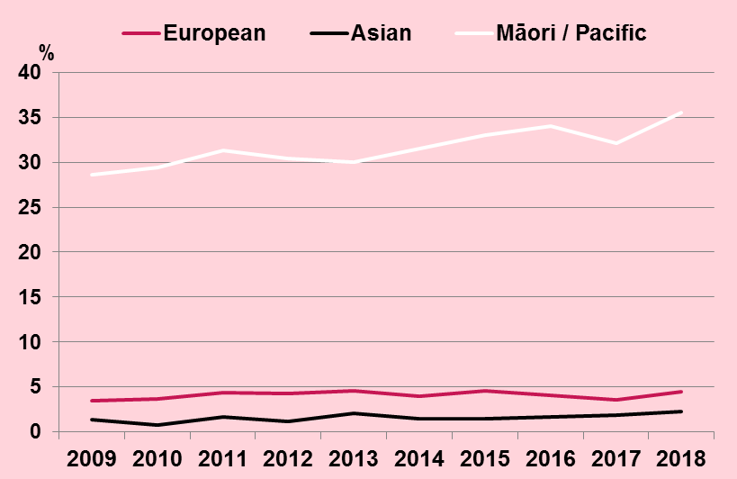
Older, more diverse, skewed, bigger wealthy as well as poor, complex.
Maternal Age
Parity
Ethnicity
Ethnicity / age
Ethnicity / smoking
Ethnicity / BMI>35

Slide 11
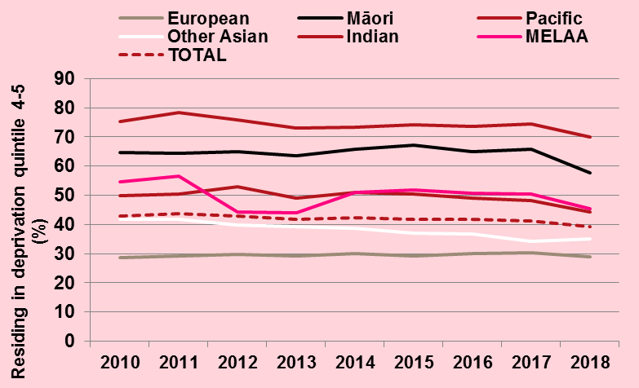
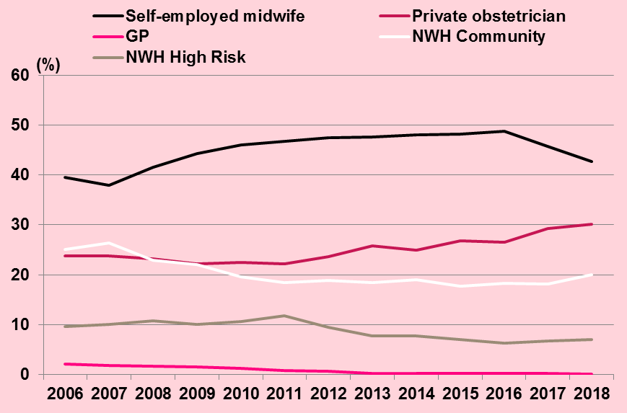
Why is NWH unique.
NZ’s leading Tertiary/Quaternary provider of obstetric services (55%/100% of NZ’s population)
Unique demographic casemix which is very different to other NZ units
We are popular (34% from outside ADHB catchment)
LMC -
Deprivation4/5

Slide 12
The end result

Slide 13
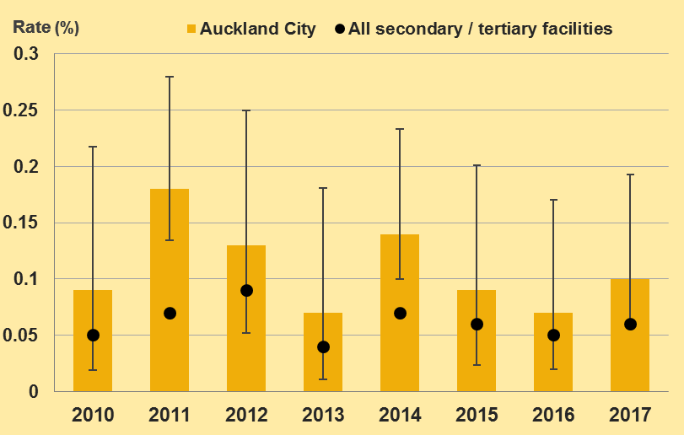
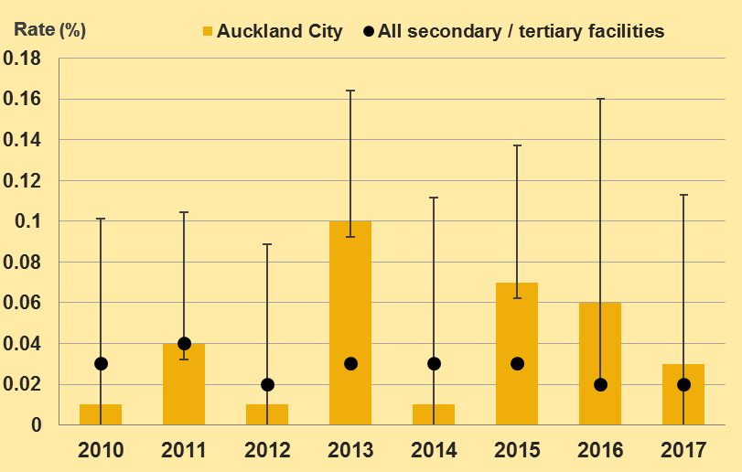
Maternal M and M
In 2018 there was one maternal death among women who birthed at ACH.
Diagnosis | 2016 |  | 2017 |  | 2018
 | N=7241 |  | N=6846 |  | N=6481
 | n (/1000) |  | n (/1000) |  | n (/1000)
Emergency peripartum hysterectomy | 5 | 0.7 | 7 | 1.0 | 8 | 1.2
Ruptured uterus | 2 | 0.3 | 2 | 0.3 | 3 | 0.5
Amniotic fluid embolism | 0 |  | 0 |  | 0
Eclampsia | 1 | 0.1 | 0 |  | 1 | 0.2
Transfusion > 4 units red cells* | NA |  | NA |  | 23 | 0.4
Admission to DCCM/CVICU | 26 | 3.6 | 69 | 10.4 | 82 | 12.7
Hysterectomy
ICU admission ventilation

Slide 14
ICU
In 2017 and 2018, there were more admissions to DCCM/CVICU
72 admissions to DCCM
19 to CVICU
11 women were antenatal
72 women postnatal.
One woman had both antenatal and postnatal admissions to intensive care.
Four pregnant women were admitted to DCCM at ACH who did not birth at NWH/ACH.

Slide 15
ICU admissions
Maternity admissions to intensive care EWS 2015/16

Slide 16
Perinatal mortality rate, perinatal related mortality rate, fetal death rate and neonatal mortality rate NWH 1991-2018 (all rates expressed as deaths/1000 births)
In 2018, (38) 46% of all perinatal related deaths that occurred
at NWH were to women who did not reside in the ADHB area.

Slide 17
In 2018 there were no stillbirths at 41+0 or greater gestation.
 |  | Total neonatal deaths N=26 |  |  | < 37 weeks n=22 |  | > 37 weeks n=4
 |  | n |  | % | n | % | n |  | %
Extreme prematurity |  |  | 8 | 31 | 8 | 36 |  | 0
Congenital abnormality | 14 |  |  | 54 | 10 | 46 |  | 4 | 100
Infection |  |  | 2 | 8 | 2 | 9 |  | 0
Neurological |  |  | 1 | 4 | 1 | 5 |  | 0
Cardio-respiratory disorders |  |  | 0 |  | 0 |  |  | 0
Other |  |  | 1 | 4 | 1 | 5 |  | 0

Slide 18
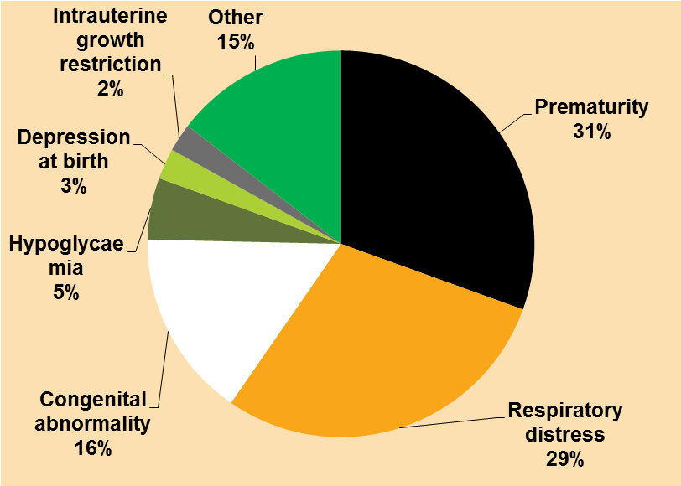
Survival of babies admitted to NICU

Slide 19
Outcomes for babies
The hypoxic ischaemic encephalopathy rate per 1000 term births at NWH for 2006-2018 was 0.73 (95%CI 0.56-0.94).
This rate is significantly lower than the national rate (1.21/1000 term births 2010-2016 (PMMRC 2018)).
The rate of severe IVH was very low in 2018. Only one baby (23 weeks gestation), was diagnosed with a grade IV /III IVH.
In 2018, 91% of NWH babies admitted to NICU at <32 weeks gestation received some antenatal corticosteroids

Slide 20
Term Neonatal morbidity
Patterns of Maternity care
in NHS trusts 13/14 RCOG 2016

Slide 21
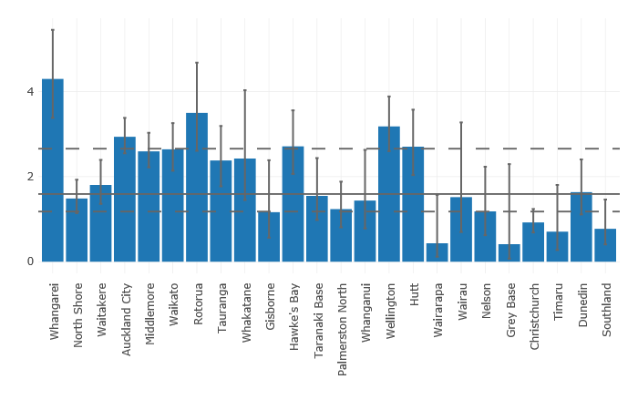
% Resp distress 37+ weeks
MOH Maternity Clinical Indicators 2017

Slide 22
The Service.
Booking
Antenatal care
Labour
Mode of Birth
PN Care

Slide 23
NZ National data
Table 17: New Zealand Maternity Clinical Indicators 2017 (NWH and NZ Facility rates for all secondary and tertiary facilities)
Indicator |  | NWH 2017 | NZ 2018 | Comment | Reference
 |  | % | %
1 | Registration with a LMC in the first trimester of pregnancy | 75.9 | 72.6 | No Concern
2 | Standard primiparae who have a spontaneous vaginal birth | 47.1 | 58.3 | Concern | Figure 94
3 | Standard primiparae who undergo an instrumental birth | 25.1 | 19.5 | Concern | Table 103
4 | Standard primiparae who undergo Caesarean section | 27.1 | 21.0 | Concern | Table 103
5 | Standard primiparae who undergo induction of labour | 11.3 | 8.8 | Concern | Figure 87
6 | Standard primiparae with an intact lower genital tract (no 1st- to 4th-degree tear or episiotomy) | 6.8 | 19.0 | Concern | Figure 116
7 | Standard primiparae undergoing episiotomy and no 3rd or 4th degree perineal tear | 49.2 | 30.0 | Concern | Figure 117
8 | Standard primiparae sustaining a 3rd or 4th degree perineal tear and no episiotomy | 3.6 | 4.2 | No concern
9 | Standard primiparae undergoing episiotomy and sustaining a 3rd or 4th degree tear | 2.2 | 2.1 | No concern
10 | Women having a general anaesthetic for caesarean section | 6.1 | 8.2 | No concern
11 | Women requiring a blood transfusion with caesarean section | 2.9 | 3.1 | No concern
12 | Women requiring a blood transfusion with vaginal birth | 3.0 | 2.4 | No concern
13 | Diagnosis of eclampsia at birth admission | 0.004 | 0.003 | No concern
14 | Women having a peripartum hysterectomy | 0.013 | 0.056 | No concern
15 | Women admitted to ICU and requiring ventilation during the pregnancy or postnatal period | 0.004 | 0.016 | No concern
16 | Maternal tobacco use during postnatal period | 1.1 | 9.9 | Excellent !!!!!!
17 | Preterm birth | 8.3 | 8.4 | No concern
18 | Small babies at term (37 - 42 weeks’ gestation) | 3.9 | 3.2 | No concern
19 | Small babies at term born at 40 – 42 weeks’ gestation | 23.4 | 30.4 | Excellent !!!!!!!
20 | Babies born at ≥37 weeks’ gestation requiring respiratory support | 2.9 | 2.2 | Concern | Figure 130

Slide 24
The Service.
Booking
Antenatal care
Labour
Mode of Birth
PN Care

Slide 25
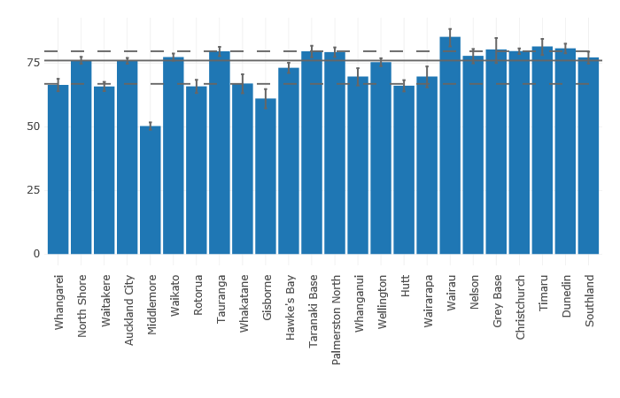
Registration with an LMC in the first trimester of pregnancy
MOH Maternity Clinical Indicators 2017

Slide 26
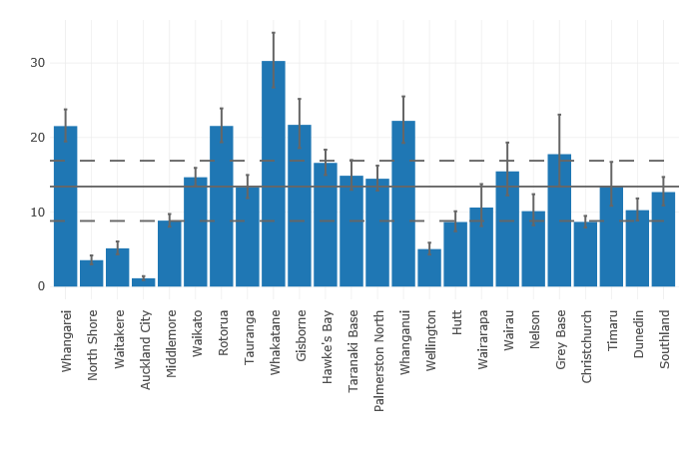
Maternal tobacco use in postnatal period
MOH Maternity Clinical Indicators 2017

Slide 27
The Service.
Booking
Antenatal care
Labour
Mode of Birth
PN Care

Slide 28
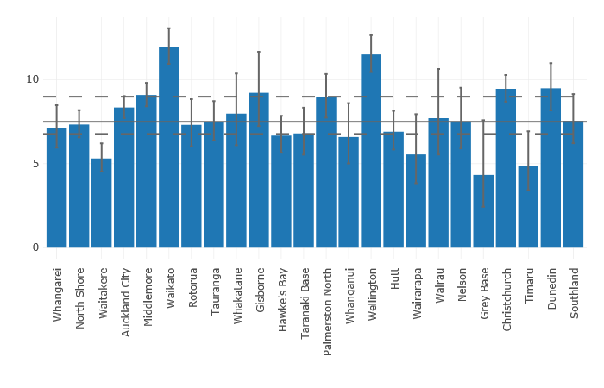
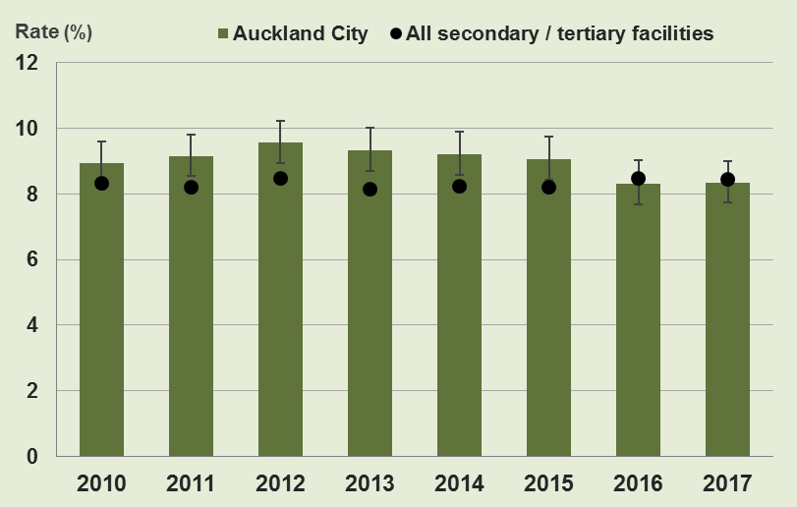
Preterm birth rates
MOH Maternity Clinical Indicators 2017
MOH Maternity Clinical Indicators 2017

Slide 29
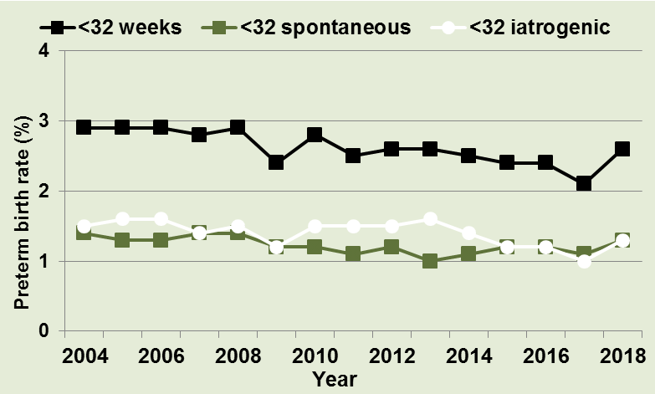
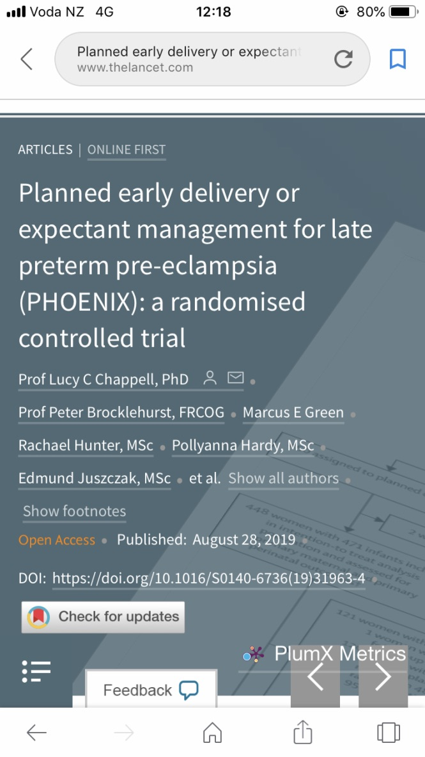
Contributors to PTB

Slide 30
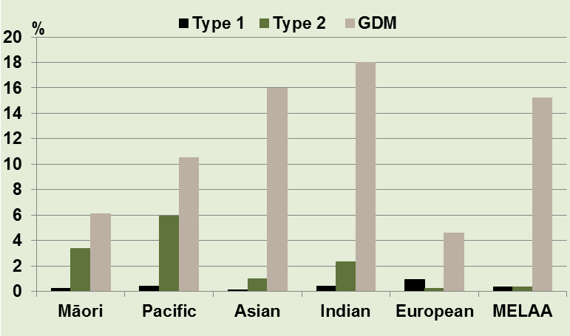
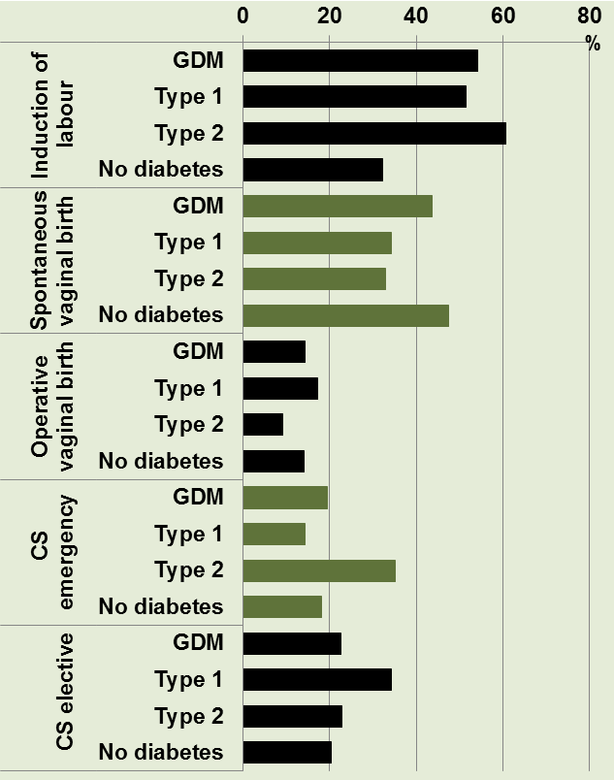
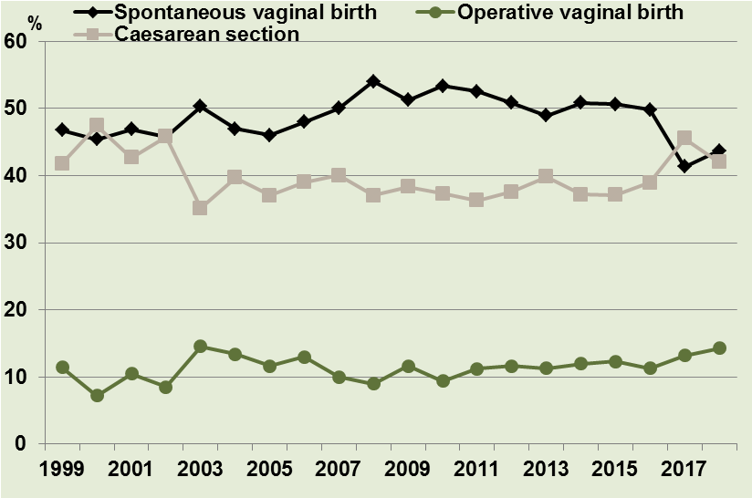
Diabetes services

Slide 31
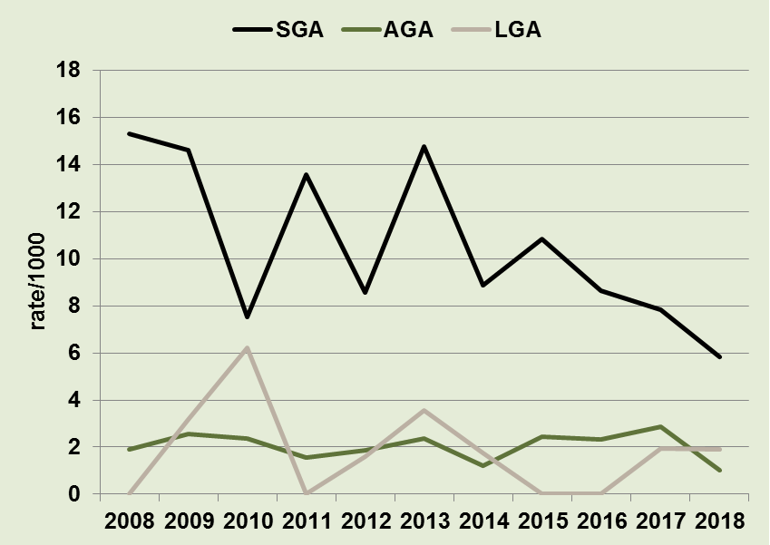
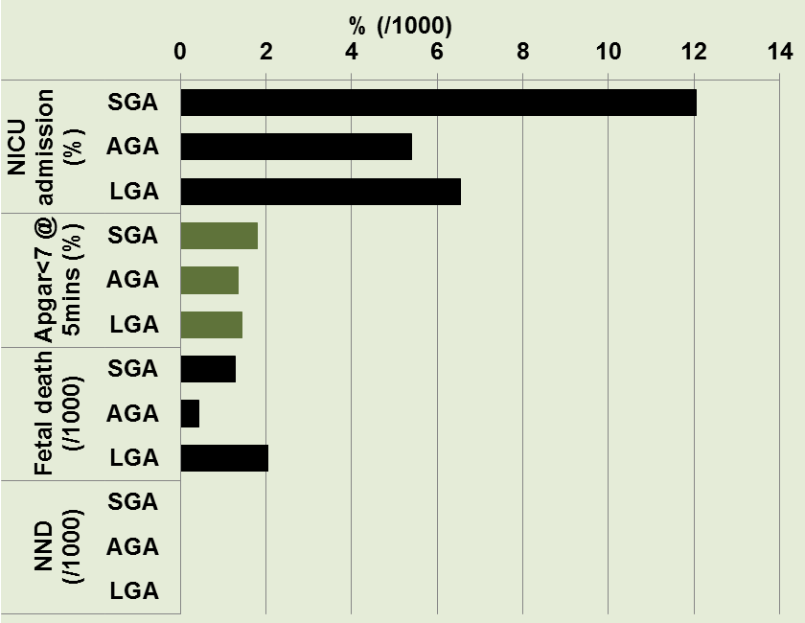
SGA
Figure 49: Perinatal related mortality rate (/1000 births) among SGA, AGA, and LGA singleton non-anomalous babies born at ≥26 weeks 2008-2018

Slide 32
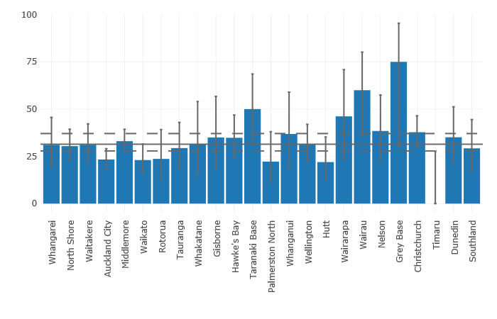
% SGA 40+ weeks
MOH Maternity Clinical Indicators 2017

Slide 33
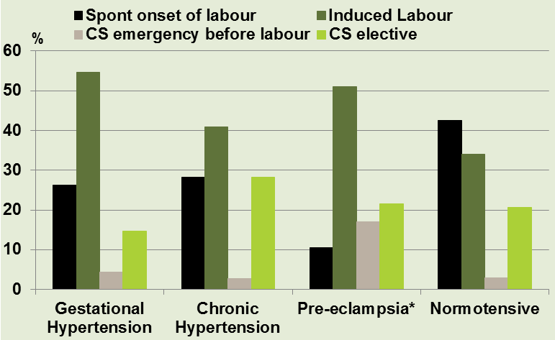
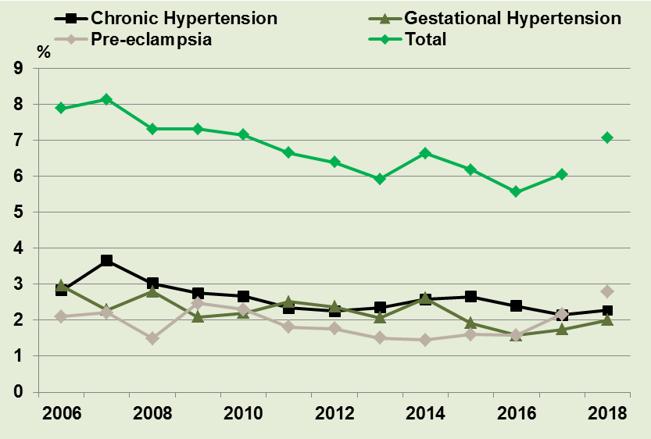
Hypertensive disease

Slide 34
Drivers to IOL rates
10% hypertension
12% Diabetes
SGA detection rates
Reduced FM awareness is very topical
Demographics (Age, IVF, BMI, ….)
ALL PUSH IOL RATES UP

Slide 35
The Service.
Booking
Antenatal care
Labour
Mode of Birth
PN Care

Slide 36
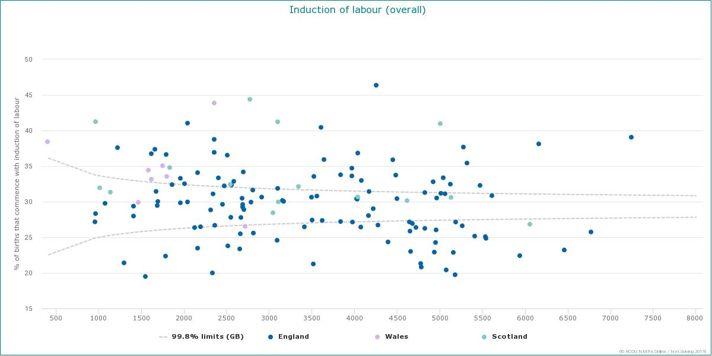
Mode of onset of Birth
Table 3: Mode of onset of birth NWH 2018
 | Birthing Mothers
 | N=6481
 | n | %
Spontaneous onset of labour | 2633 | 40.6
Iatrogenic onset of birth | 3848 | 59.4
CS Elective | 1336 | 20.6
Emergency CS before onset of labour | 222 | 3.4
Induction of labour | 2290 | 35.3
Patterns of Maternity care
in NHS trusts 13/14 RCOG 2016

Slide 37
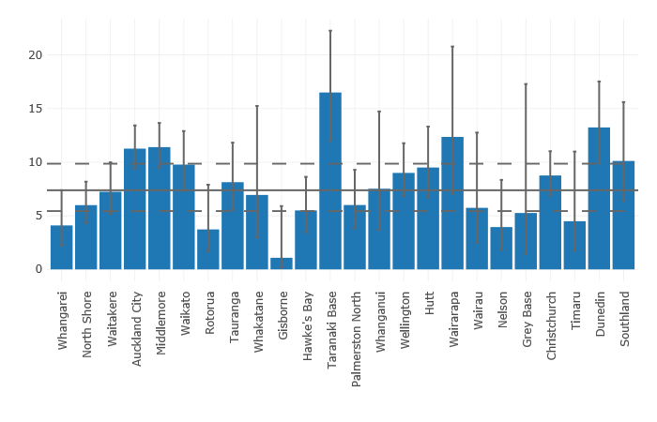
IOL (Primips)
MOH Maternity Clinical Indicators 2017

Slide 38
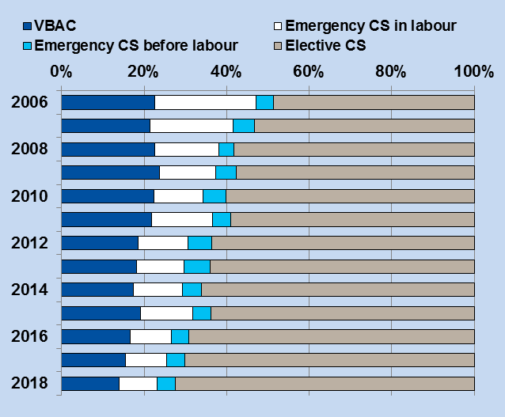
VBAC attempts
Patterns of Maternity care
in NHS trusts 13/14 RCOG 2016

Slide 39
VBAC success 15.9% - overall (from 699 women)
Patterns of Maternity care
in NHS trusts 13/14 RCOG 2016

Slide 40
The System.
Booking
Antenatal care
Labour
Mode of Birth
PN Care

Slide 41
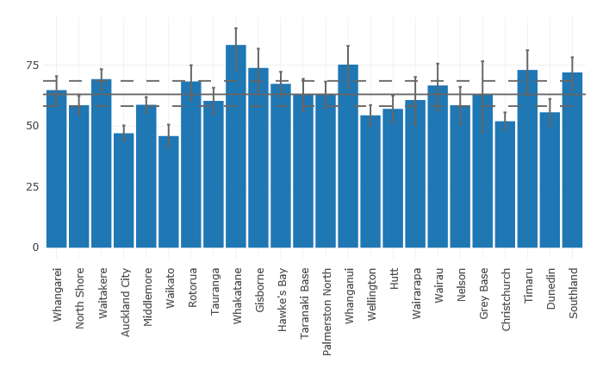
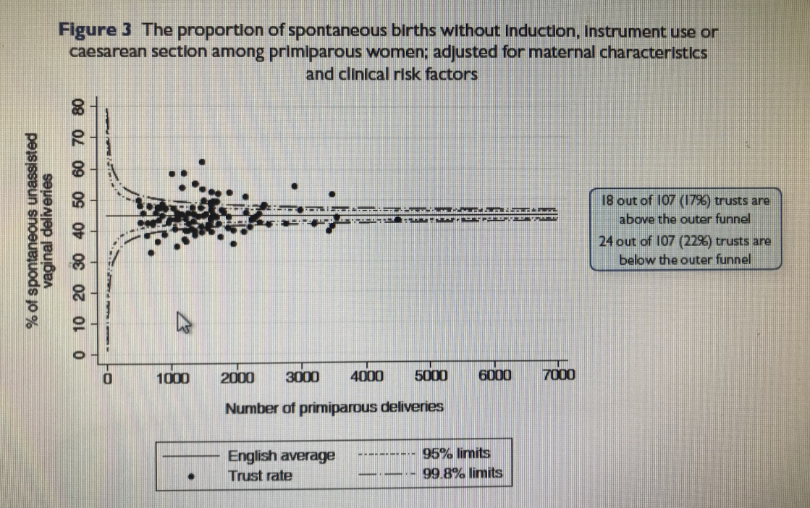
SVD amongst standard primips
MOH Maternity Clinical Indicators 2017
Patterns of Maternity care in NHS trusts 13/14 RCOG 2016

Slide 42
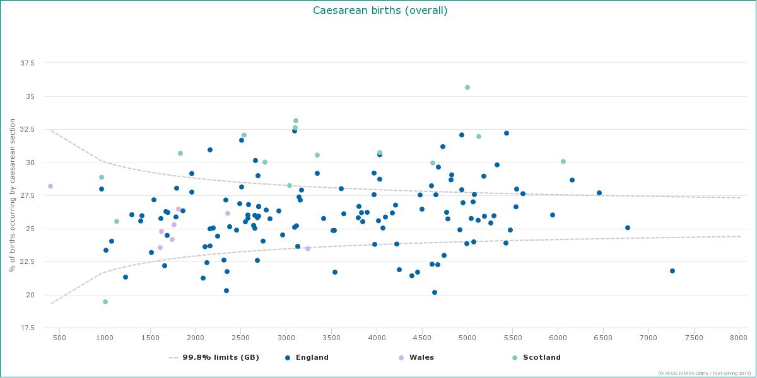
Caesarean birth
Table 4: Mode of birth by parity NWH 2018
 | Birthing Mothers |  | Nullipara |  | Multipara
 | N=6481 |  | N=3183 |  | N=3298
 | n | % | n | % | n | %
Spontaneous Vertex Birth | 2998 | 46.3 | 1145 | 36.0 | 1853 | 56.2
Vaginal Breech Birth | 36 | 0.6 | 19 | 0.6 | 17 | 0.5
Operative Vaginal Birth | 915 | 14.1 | 756 | 23.8 | 159 | 4.8
Forceps | 302 | 4.7 | 251 | 7.9 | 51 | 1.5
Ventouse | 613 | 9.5 | 505 | 15.9 | 108 | 3.3
Caesarean Section | 2532 | 39.1 | 1263 | 39.7 | 1269 | 38.5
CS Elective | 1336 | 20.6 | 394 | 12.4 | 942 | 28.6
CS Emergency | 1196 | 18.5 | 869 | 27.3 | 327 | 9.9
Patterns of Maternity care
in NHS trusts 13/14 RCOG 2016

Slide 43
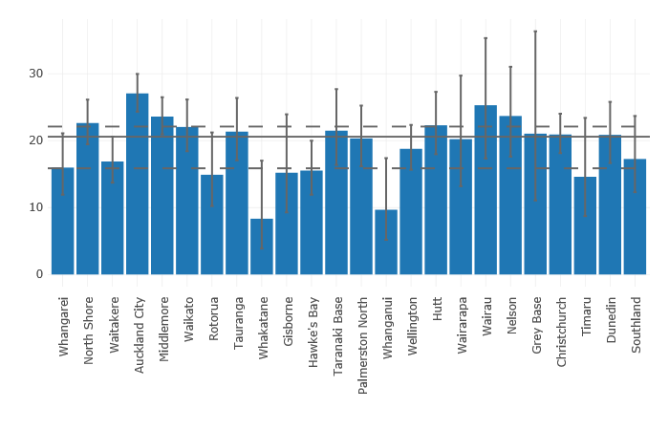
Caesarean section (Primips)
MOH Maternity Clinical Indicators 2017

Slide 44
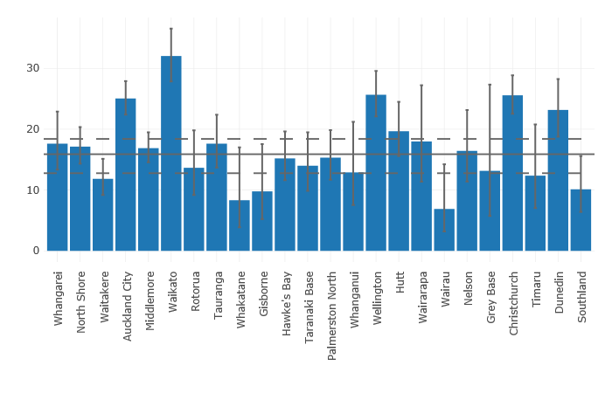
Instrumental
MOH Maternity Clinical Indicators 2017

Slide 45
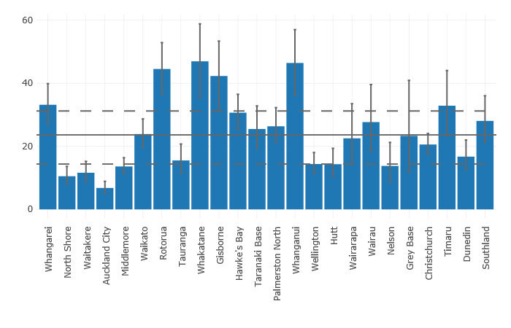
Intact perineum
MOH Maternity Clinical Indicators 2017

Slide 46
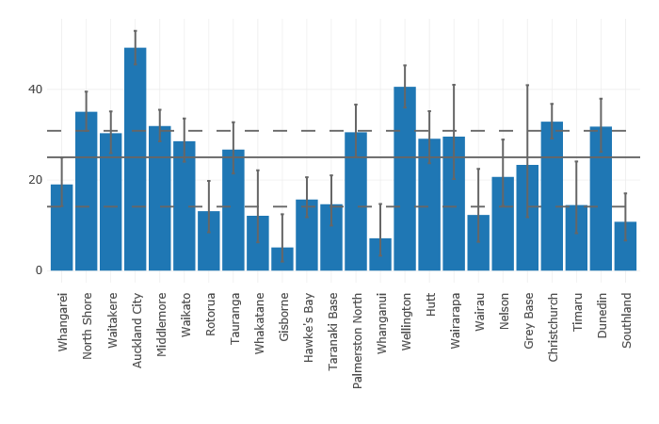
Episiotomy
MOH Maternity Clinical Indicators 2017

Slide 47
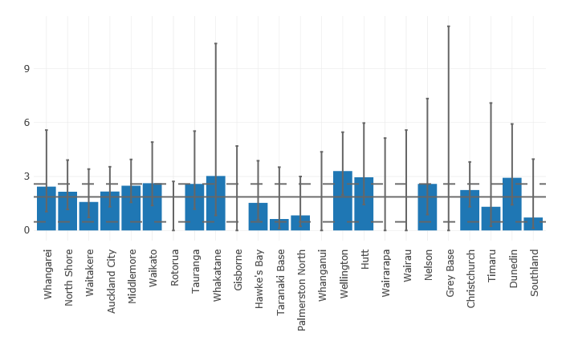
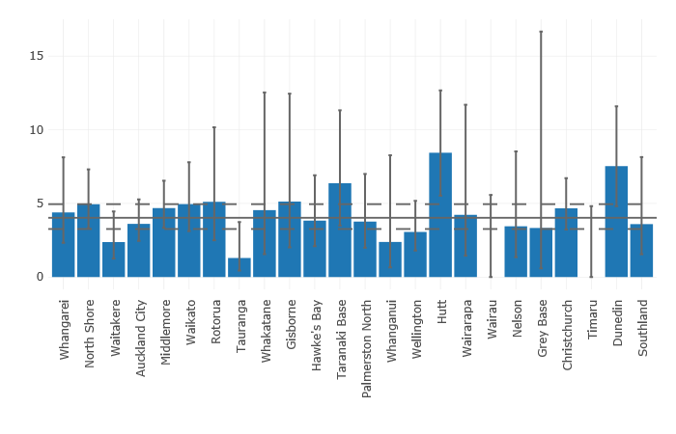
3rd 4th degree tear with Epis’
3rd 4th degree tear no Epis’
MOH Maternity Clinical Indicators 2017

Slide 48
3rd 4th degree tears

Slide 49
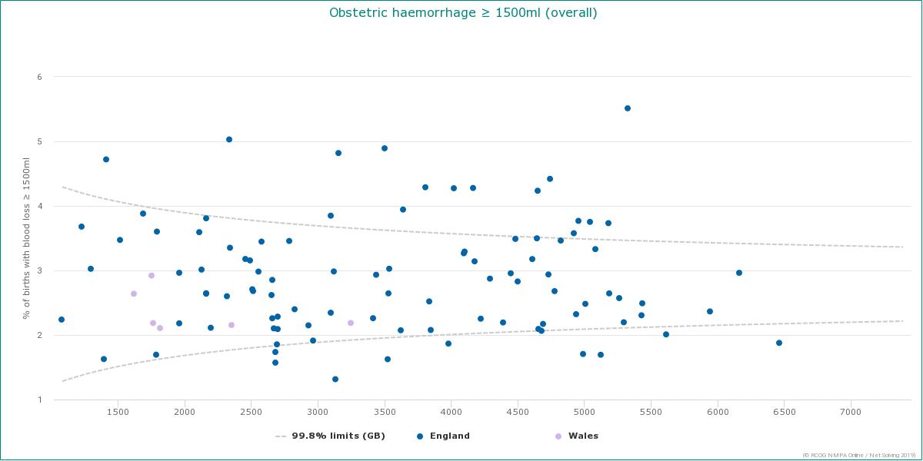
Table 7: Maternal postpartum outcomes NWH 2018
 | Birthing mothers | n | %
PPH >1000mls | 6481 | 655 | 10.1
Spontaneous vaginal birth | 3034 | 239 | 7.9
Instrumental vaginal birth | 915 | 124 | 13.6
Caesarean section | 2532 | 292 | 11.5
Episiotomy among vaginal births | 3949 | 1308 | 33.1
Third / fourth degree tears among vaginal births | 3949 | 142 | 3.6
Postpartum blood transfusions | 6481 | 166 | 2.6
Patterns of Maternity care
in NHS trusts 13/14 RCOG 2016

Slide 50
The Service.
Booking
Antenatal care
Labour
Mode of Birth
PN Care

Slide 51
What’s happening in PN
Great breastfeeding figures
Great smoking figures
Complaints are rising in this area
Significant staffing pressures

Slide 52
What’s good……
Neonatal outcomes
Maternity outcomes – severe morbidity
Complaints
Governance
The quality chapter – 3
The service is responding to the challenges.

Slide 53
What’s still a challenge
The “intervention rate” :
IOL ??? - maybe
Elective CS
Primips
VBAC
Emergency CS
Primips
Full dilatation CS
Perineal trauma ??? – maybe

Slide 54
Age of staff

Slide 55
The quality agenda (Ch 3)
Seems to be proven to work as areas of focus are the best areas in the report.
No real areas identified within the quality framework that might address some of the service outcomes / pressures in the ACR

Slide 56
Thank you
I am so glad to be back !!

