Slide 1
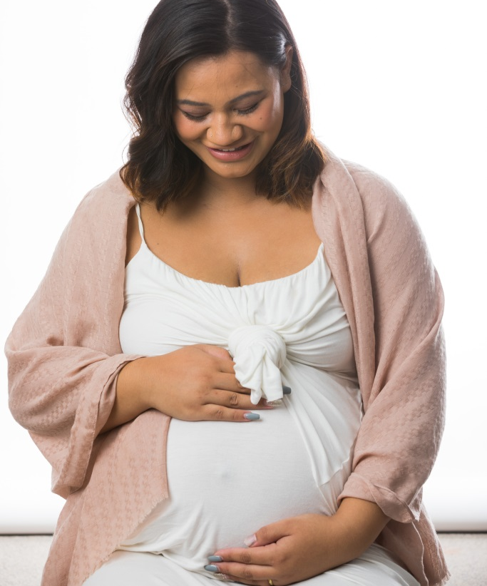
National Women’s Hospital Annual Clinical Report- Midwifery Commentary 2018
Deb Pittam
Director of Midwifery
Notes:
I have been here 4 months and when asked to do this presentation found it quite hard to decide where to start. This report is huge and incredibly comprehensive.
I have come to quite a few of the ADHB report days over the years and have really enjoyed them so I hope this isn’t too bad for those of you new to coming today! What I will share though before I start is that I have been completely blown away since I came here by the calibre of practice and the work ethic of midwives, doctors, nurses, HCAs actually all staff I have met throughout the organisation.
I came into a situation where we were significantly short of midwifery staff to a degree I have never experienced in my career and yet felt incredibly welcome and while I saw staff at times in what I call “survival mode”

Slide 2


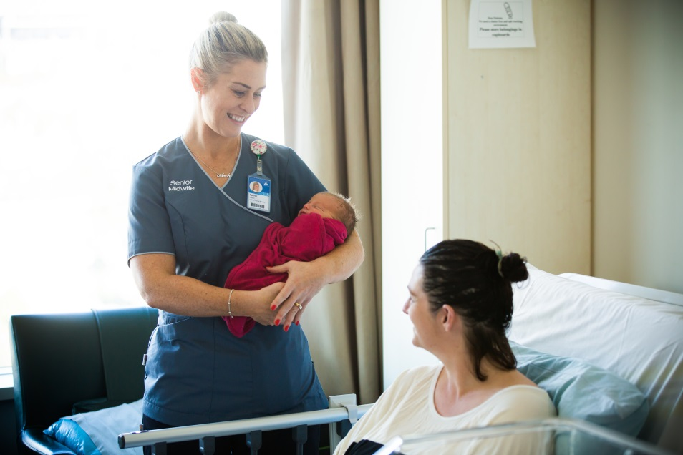

Notes:
in that environment they were just working incredibly hard and still managing to achieve this picture….
The mix of caseload here is a hugely complex environment to work in, and I have seen amazing examples of teamwork, teaching, fantastic practice and complete commitment and just wanted to start with a huge thank you all for the work you do in every part of the service.
We have seen an increase in contracted midwifery FTE over the past few months, have some great nurses working with our midwives and have some additional work underway to try to support our midwives to stay with us and hopefully a new leadership model which will continue to support them going forward. So at the risk of being known as a Pollyanna I have some confidence.
Next year I am planning for our general demeanour to shift from this…

Slide 3


Notes:
To this…..We will see I guess!!
Anyway on to business… I thought perhaps I’d start by putting midwifery professional practice into context …
There are some fundamentals which underpin who we are.

Slide 4
Principles by which we provide midwifery
The woman/person, baby and whanau are at the centre of all decision making and care provision and planning - MOH
The woman/person and those she chooses to share decision-making with are entitled to receive full, accurate, unbiased information about options and the possible outcomes of decisions and has the right to decline care, referral and transfer once she has been given all appropriate information with which to make that choice. – NZ MOH Referral guidelines
“The midwife applies comprehensive theoretical and scientific knowledge with the affective and technical skills needed to provide effective and safe midwifery care.”
The midwife understands, promotes and facilitates the physiological processes of pregnancy and childbirth, identifies complications that may arise in mother and baby…NZMC
Recognises Maori as Tangata Whenua of Aotearoa
Every action the midwife makes, from her first interaction with the woman, needs to support
keeping birth normal thereby supporting the normal cascade that occurs when labour and
birth happen physiologically. - NZCOM
The midwife works in partnership with the woman/wahine throughout the maternity experience.”
promotes and provides or supports continuity of midwifery care
Notes:
I don’t’ expect you to read all these but it is clear that there are some actions and activities which underpin all aspects of care midwives provide. Whether you are looking at the council competencies, The College Standards for Practice and Practice Guidance, Ministry documents such as the section 88 document or the associated referral guidelines. There is no doubt we are educated, trained and responsible to work to support the physiological process of pregnancy, labour and birth in the first instance while ensuring women are given the appropriate information with which to make choices, and that when intervention or additional service is necessary we either provide that care or facilitate access to it.
These basic principles are central to our philosophy, our ethics and safe provision of care.
Continuity of midwifery care models are supported internationally and shown to be associated with reduced incidence of preterm birth, reduced incidence of perinatal death, reduced intervention and high levels of consumer satisfaction.
What we are interested in today however is to see if midwifery led, continuity of care in our setting is associated with different outcomes for mothers and babies compared to other models and what those differences are. There is no judgement intended here and no attempt to suggest any one factor which leads to any variation we find. That is a big question for another day and some robust research I believe.

Slide 5
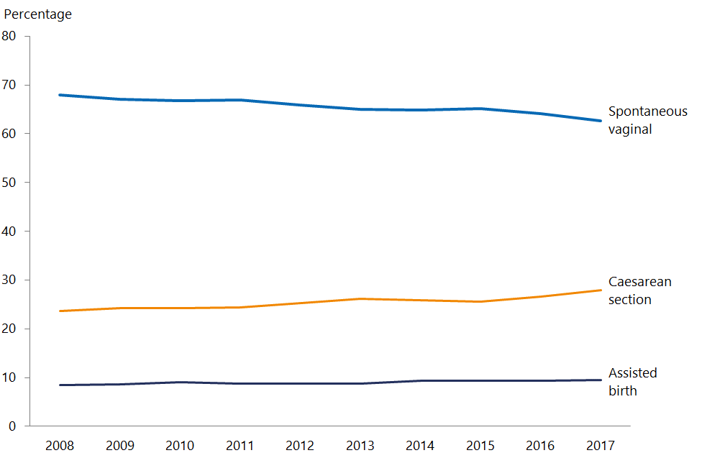
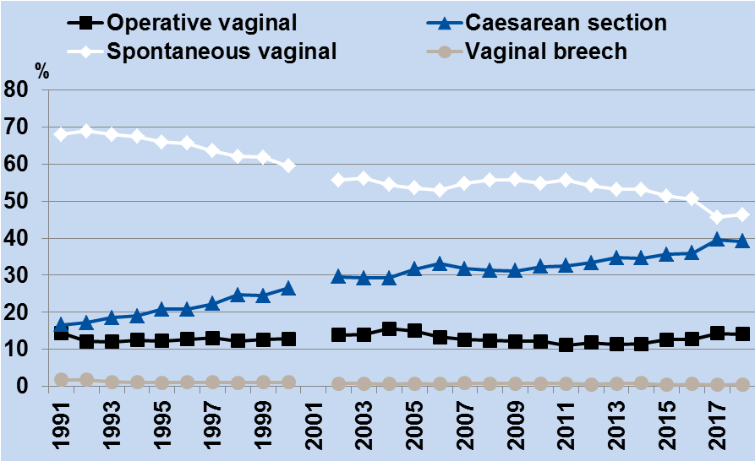
Mode of Birth in NZ and NWH
Figure 90: Mode of birth NWH 1991–2018
Report on Maternity - 2017
NW Clinical Report - 2018
Notes:
So I just want to start by setting the scene….
This is a comparison between the information for the whole of NZ from the report on maternity 2017 and the information in our current NWH Annual Clinical Report. We can clearly see a gentle but definite reducing spontaneous birth rate from around 68% to 62% in the NZ data and a gently rising caesarean section rate from about 23% to 28%.
The arrow identifies the 2008 starting point of the whole of NZ graph and you can see that looking at trends in the national data compared to ours there are similarities. There does appear to be a steeper slope downwards in the vaginal birth rate at NWH since 2008 than the NZ data. Having said that as you can see at the arrow point spontaneous birth rates at NWH in 2008 were around 56% compared to 68% in the national data so already quite different, similarly with the rising caesarean section rate.
So lets have a look a little bit more closely at a comparison of these data from 2017.

Slide 6
Notes:
We saw that the gap had widened over time on the last slide and here we can see there are very significant differences in spontaneous vaginal birth rates at NWH compared to the whole of NZ data.
In 2017 if you came to NWH to have your baby, you were about 17% less likely to have a spontaneous vaginal birth, 4½% more likely to have an assisted birth and 11% more likely to have a caesarean section than you would have been in a hospital with rates closer to the national data.
I thought it would be useful to have a look and see how NWH caesarean section rates compared internationally – just in case NZ is the outlier.

Slide 7
NWH 2018
Report on Maternity 2017
Notes:
So although these data are a few years old and rates have risen a little actually not that dramatically in other parts of the world and here we are about the same as Korea at just under 40% and with a rate equal to being one of the top 5 rates of caesarean section in all OECD countries. There is the whole of NZ sitting around the 26% mark and about the same as the UK in the 2015 data.
The question I am going to ask is why? Can we say that this is ‘driven’ by our population? I used to hear that a lot in Northland… (It is Ethnicity, It is poverty, It’s choice!).
Just in case lets look at the national indicator data on mode of birth which only reports on the standard primiparous women.

Slide 8
Caesarean sections in standard primiparae at NWH
Notes:
As you know the standard primip is a woman expected to have an uncomplicated pregnancy giving birth for the first time. She is aged 20 – 34, at term (37 – 41 weeks) is carrying a cephalic, singleton baby and there have been no recorded obstetric complications which might require specific interventions. Interestingly it appears we have a fairly low risk primip population at ACH since we have the highest rate of standard primps in our population compared to all the DHBs which is 16.7% this year.
Despite that and knowing that the average rate of caesarean sections in this population by facility in NZ in 2017 was 21%,
At NWH 27.1% of our standard primip population experienced a caesarean section. That is almost 1/3 of primiparous women with no risk factors birthing at Auckland City Hospital. This was the highest value since 2010 for standard primps in NWH.
The assumption underpinning the use of the standard primip as a way of benchmarking facilities and regions regarding outcomes is that we expect that a similar woman should have similar outcomes regardless of the hospital they enter or the carer they choose. Is this a reasonable assumption and if not why not? It is clearly not the case in NZ with sometime very variable outcomes on a broad range of indicators around the country.
So what are our most common reasons for doing caesarean sections at NWH

Slide 9
Indications for LSCS
Notes:
And why do women have caesarean sections at ADHB in larger numbers than they do elsewhere and what are our reported reasons for induction? We will talk about repeat LSCS later but for now lets look at primps.
For a start, of our indications for Caesarean section apparently 20.2% of our first time mums have a malpresentation? I am a little surprised by that number, by definition malpresentation is usually considered when a fetus presents in a position other than cephalic and so really include breech and transverse or oblique lie. It seems a bit incomprehensible that 1 in 5 first time mums would have a baby with a malpresentation.
21.3% just want a caesarean section – it doesn’t tell us why?? and 11.9% have a C-Section because their inductions are unsuccessful. These three indications are responsible for 53% of all our caesarean sections.
The MOH state they don’t fund LSCS for maternal request and we did 165 of these major operations in 2018. A rough estimate of the potential loss of revenue associated with that number is well over $800,000 and it is likely immediate and on-going service costs for these women and their babies is significantly higher than that.
So according to The ARRIVE trial, Grobman tells us that induction of labour at 39 weeks leads to lower LSCS rates with no immediate adverse affects on mother or baby. Is this what we see at NWH? Lets look at IOL broadly

Slide 10
Notes:
In the Report on Maternity 2017 data 25.5% of women giving birth in NZ had an induction of labour
At NWH in that same year 41.2% of women experienced an induction of labour That little arrow is the NZ figure, what is particularly surprising to me is where we sit with our nullip population
How do we benchmark in the standard primip population?

Slide 11
IOL in Standard Primiparous women at NWH
NZ Clinical Indicators 2017
Notes:
In 2017 our rate of induction of labour in standard primiparous women was over 10% compared to the national average of 7.6% Once again we are an outlier with higher rates of induction in this group of women.
So do women at NWH who have an induction of labour have a reduced incidence of caesarean section as the Arrive trial indicates would be the case?

Slide 12
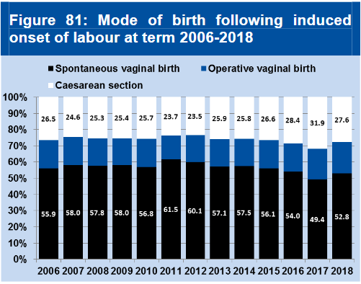
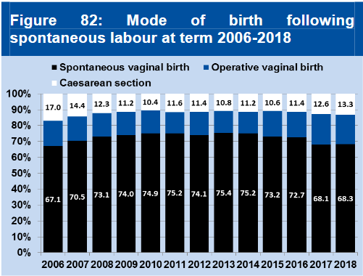
Notes:
We can see from the data here from this years report this is not the case at NWH.
Since 2006 women who have been induced have had a higher incidence of caesarean section and a lower rate of spontaneous birth than those who spontaneously went into labour at term. Of course these are all women not just low risk but the difference is large.
In 2018 of all women who went into spontaneous labour only 13.3% had a caesarean section whereas 27.6% of women who had an induced labour experienced a caesarean section.

Slide 13
Notes:
So looking at a comparison of nullips and multips induction rates are high in both groups compared to national rates of around 25% overall. If we look at all our nulliparous women at ADHB we see that we induced in 2018 44.5% of these women. I have to say I find it hard to understand why we are having to induce almost half of our first time mums here. It makes no sense to me that we should need to do that, but it is happening.
Excluding women who had a previous caesarean section, we induced 41.5% of our multiparous women.
There are some differences in the ethnicity data but none of our ethnic groups in ADHB have comparable rates of Induction of labour as their counterparts in other parts of NZ. And though still high Maori women have lower rates than Pacific or European women but still quite high rates comparably with other regions so it doesn’t really appear that ethnicity is a contributing factor.

Slide 14
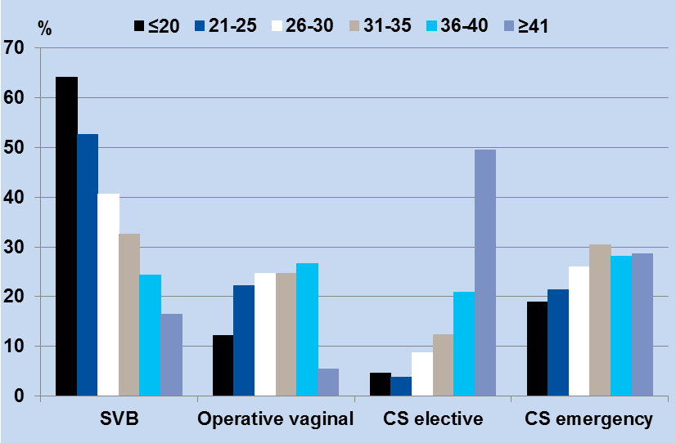
Figure 92: Mode of birth by maternal age among Nullipara NWH 2018
Notes:
According to PMMRC our babies of our young under 20 mums are significantly at risk however these women have the highest rates of vaginal birth in our population and lowest operative birth and emergency LSCS rates.
Our over 40 mums do have an increased risk of perinatal mortality and very few of them in ADHB have a spontaneous birth.
Clearly you are less likely to give birth vaginally as you age and you chances of elective LSCS increase
Definitely if we had a large number of over 40s we could agree that that was a contributing factor when half of them have elective LSCS is our age distribution different that the rest of the country and is it changing much?

Slide 15
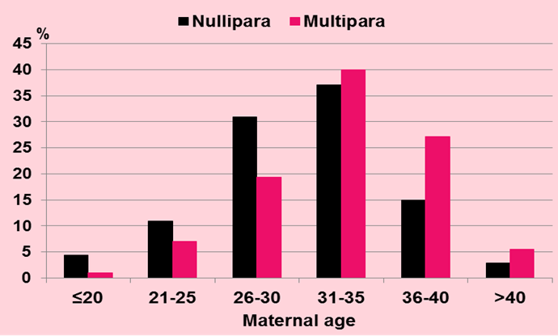
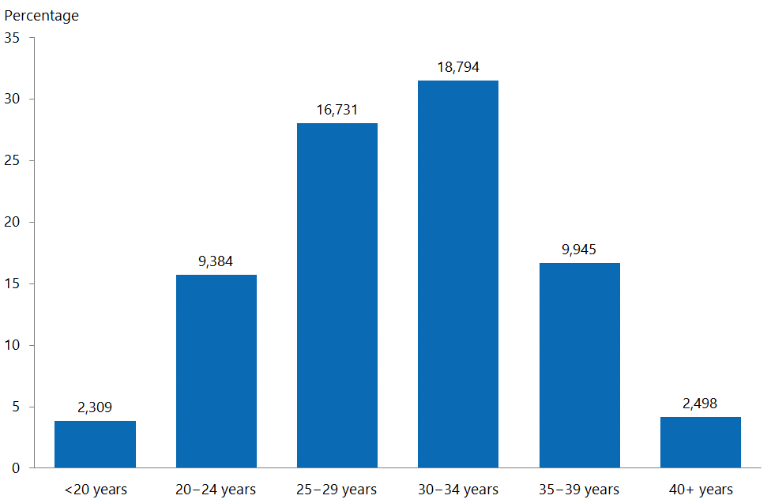
Age distribution percentage of women giving birth in 2007 – Report on Maternity
Figure 1: Percentage of women giving birth, by age group (years), 2017
Figure 19: Maternal parity by age NWH 2018
Notes:
While the distribution is similar, ADHB has a higher proportion of women between the ages of 30 and 40 than national data. Interesting though that the highest risk populations based on age according to PMMRC data are the over 40s and under 21s and these groups are represented in similar proportion compared to national data.
This is not an explanation.

Slide 16
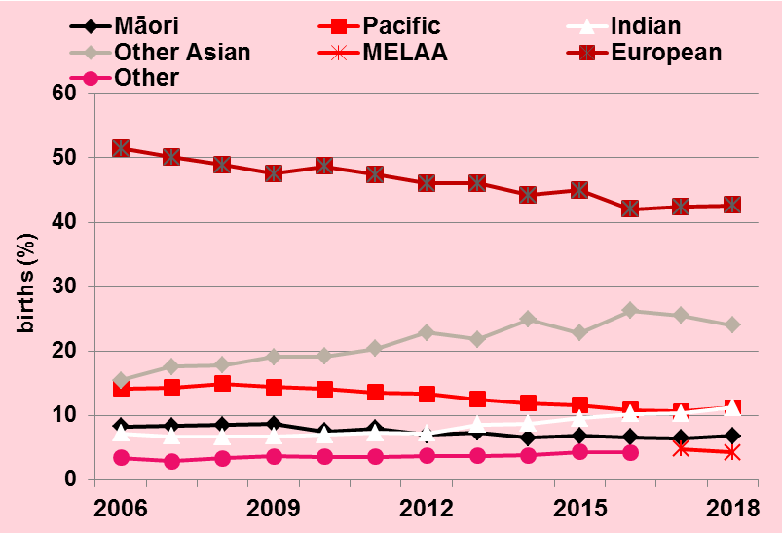
Figure 20: Ethnicity of mothers giving birth at NWH 2006-2018
Notes:
The ethnicity of mothers giving birth at ADHB is changing and is quite different from the whole of nations data. The main change being an increase in the percentage of Indian and Other Asian women and a reduction in the proportion of European women in our population.

Slide 17
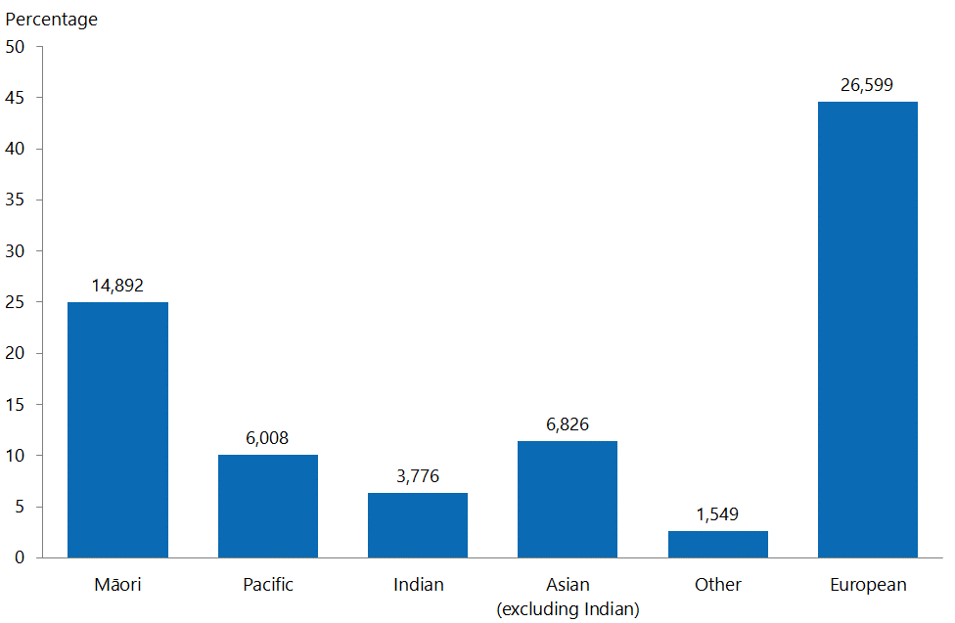
Ethnicity of birthing women in NZ 2017
Ethnicity of birthing women at NWH 2018
Reports on Maternity 2010 and 2017 Data
Notes:
Though these two graphs are not directly comparable once again, as one shows whole numbers and one percentages. They do indicate some changes in the birthing population of NZ over that time. The main change has been an increase in the proportion of Indian and other Asian women birthing. Back in 2010 The all Asian population amounted to almost 11% of the birthing population and in 2017 that proportion had increased to almost 18%
NZ and other European women amount to 41% of the population which is reasonably comparable nationally but the remainder is made up of a very even mix of all other ethnicity groups. We have a much more multicultural environment than the whole of NZ. Living in Northland I know we could see an increased risk of poor perinatal outcomes related to Maori women and increased intervention in Asian and Indian groups but the European groups were at low risk of interventions and poor outcomes there.
So if we go back and look at caesarean section rates in different ethnicities

Slide 18
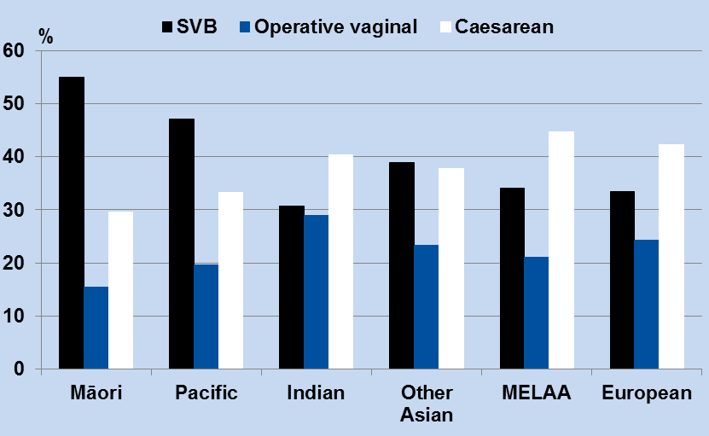
Figure 91: Mode of birth by ethnicity among nulliparous women NWH 2018
Notes:
This is the picture we see at NWH last year.
It is a similar trend to Northland that Maori women are less likely to have a caesarean section but here they along with all groups have a higher rate of caesarean section that either Northland or whole of NZ groups so we can’t really say that ethnicity is driving our increasing caesarean section rate.

Slide 19
Notes:
So I am going to try another couple of known possible explanations for increased rates lets look at the BMI distribution at NWH and compare that nationally.
Does BMI lead to increased intervention and is this different to the rest of the country. Well clearly at NWH you are more likely to have an induction as your BMI increases, you are less likely to have a spontaneous birth as your BMI increases so BMI does increase your chance of intervention at the onset of labour.
When we look a the distribution of BMI though at NWH almost 60% of women have a BMI < 25 and roughly 20% over 30 but less than 3% have BMI over 35.
When we compare this with the whole of NZ it is a little different in fact in the national 2017 data 42.4% a healthy weight and more than half were overweight or obese (28.3 and 26.5%respectively) so while increasing BMI is likely to be associated with an increase in intervention this does not explain the differences we see in our intervention rate compared to national rates as the proportion of women booked here who are overweight and obese are lower than the national figures.
So what does our LMC profile look like

Slide 20
Notes:
The vast majority of women giving birth in 2017 received primary maternity care from an LMC midwife in the whole of NZ and the remainder from their local DHB service. < 3% did not identify an LMC although these women would have been provided with some care from their local DHB
Clearly the distribution of LMC type for women booking for care at NWH is quite different from the rest of the country. There are only 5% of pregnancies and births nationally with the lead carer a Private Obstetrician whereas there are 31% at NWH. DHB midwifery care amounts to only 8% nationally but 20% here and there is a substantially reduced proportion of women cared for by community LMC midwives at NWH compared to the rest of the country in fact half the proportion.

Slide 21
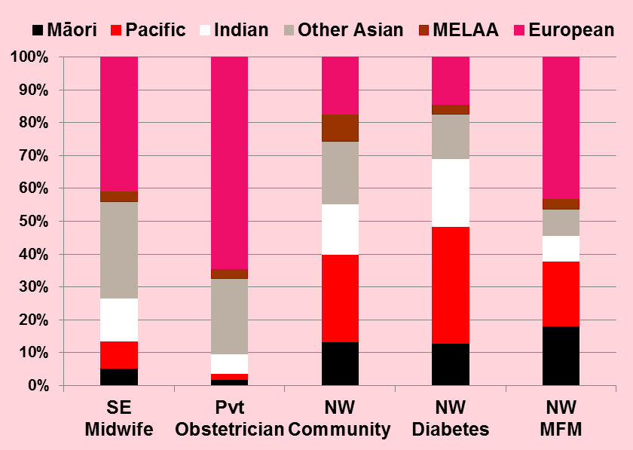
Demographic Distribution by LMC
Figure 38: LMC at birth and maternal ethnicity NWH 2018
Notes:
So I thought it would be interesting to see whether the different provider groups had substantially different demographic distribution in the population of women at NWH who accessed their care.
These graphs show the distribution of women by ethnicity, neighborhood deprivation and age in relation to LMC type. The higher risk groups for interventions are heavily represented in the high risk teams which have expected higher intervention rates but these potentially higher risk women are present in much smaller proportion in the private Obstetrician group than they are in the Self employed midwifery group or community midwifery groups however both the latter with lower intervention rates.
If poverty is a risk factor clearly women from low decile areas are not highly represented in the group accessing Private Obstetric care and the age distribution is surprisingly similar between the self employed and private obstetric groups.
So are there differences in vaginal birth rates in different provider groups and have these changed over time?

Slide 22
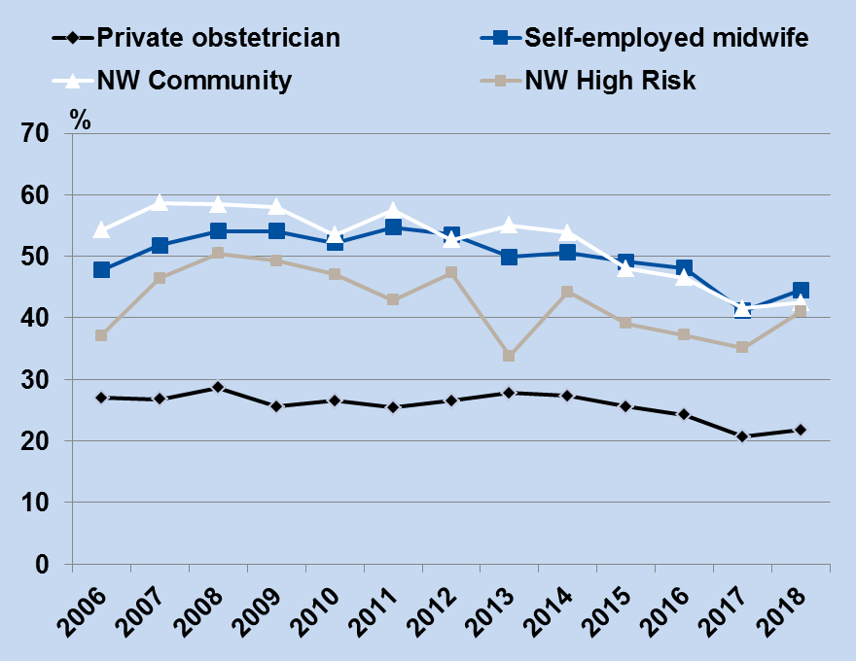
Figure 93: Spontaneous vaginal birth rate among all nullipara by LMC 2006 - 2018
Notes:
As you can see above the rates of vaginal birth do differ substantially between these groups although have not changed as much as we may have expected over time. The community midwifery group has seen a significant drop in vaginal birth rate particularly since 2012 the high risk group hasn’t changed much and all other groups have seen a decline in vaginal birth rates. In 2018 all groups aside from the private obstetricians had similar vaginal birth rates at NWH of between 41 and 45%. Still low compared to national figures but much higher than the Private Obstetric group with a rate of spontaneous vaginal birth of 22%
So there clearly is a difference by provider type and it doesn’t appear we can explain it by increased risk based on case-mix so what else is driving these differences. How much impact does provider have and why?
One area which clearly is driving our increasing caesarean section rates and will continue to do so, are the numbers of women who are having elective repeat caesarean sections after previous caesarean sections. On an earlier slide we noted that 71% of our multip caesareans occur as elective repeat caesareans. So clearly if we do lots of caesareans in our primip population and then 70% of those women have elective repeat caesarean sections in their next pregnancy clearly our rates will continue to rise.

Slide 23
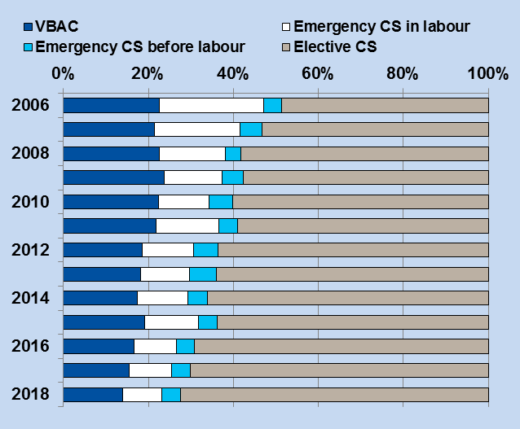
Figure 101: Mode of birth among parity 1, singleton, cephalic, term prior Caesarean pregnancies - all LMCs 2006-2018
Notes:
It is generally expected that around 74% of women who labour after 1 caesarean section will have a vaginal birth.
There are associations found in the literature associated with poor outcomes in subsequent pregnancies when there has been 1 and more repeat caesarean section.
Some of these include abnormal fetal growth, abnormal placental position and hysterectomy in future pregnancies. There is emerging evidence of increasing secondary infertility and increased incidence of long term chronic health issues in children and adults born by caesarean section.
Our ADHB VBAC guideline notes a higher risk of placenta praevia and accreta after one LSCS but after 2 there is twice that already increased risk along with hysterectomy.
So should we be accepting that large numbers of women do not plan a VBAC after 1 LSCS?

Slide 24
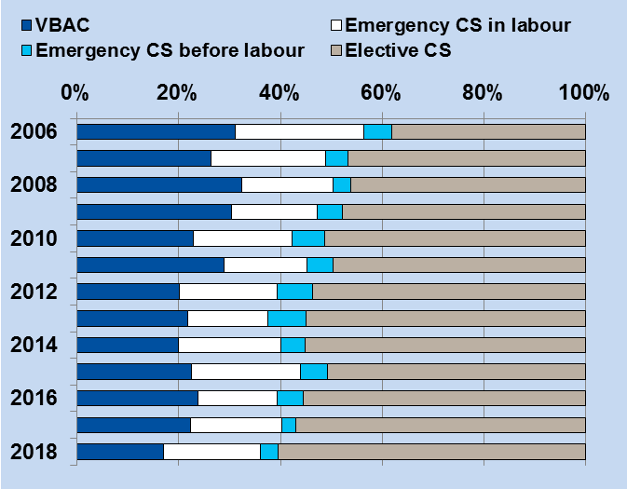
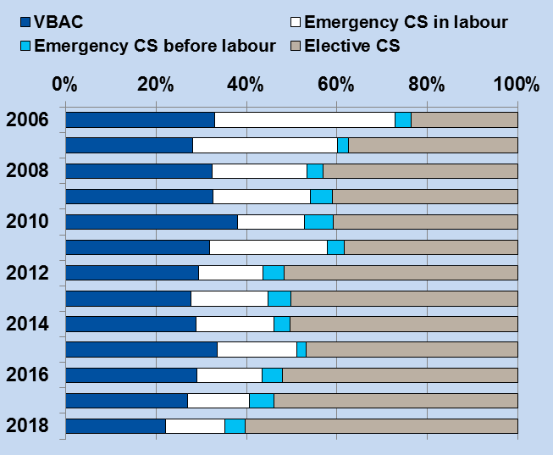
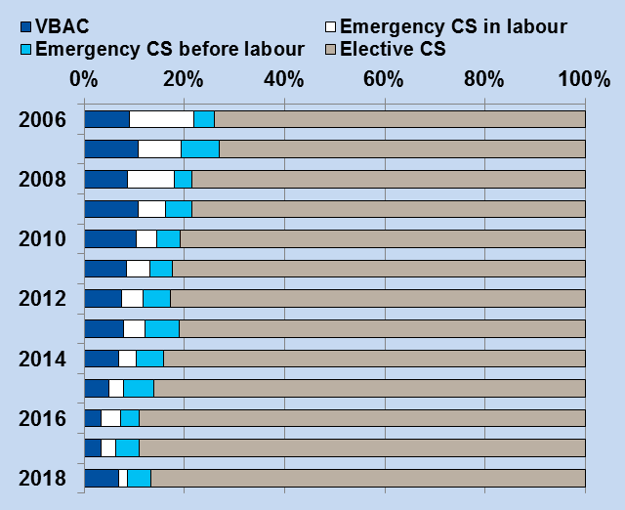
Figure 104: VBAC rates among parity 1 term cephalic singleton previous Caesarean pregnancies NWH as LMC as birth 2006-2018
Figure 103: VBAC rates among parity 1 term cephalic singleton previous Caesarean pregnancies - Self-employed midwife as LMC at birth 2006-2018
Figure 102: VBAC rates among parity 1 term cephalic singleton previous Caesarean pregnancies - Private Obstetrician as LMC at birth 2006-2018
Epidural rates
Private O&G | 83.5%
GP | 100%
Midwife LMC | 66%
MFM/MM/ Diabetes | 68-77%
Use of water in labour
Private O&G | 5.5%
Midwife LMC | 9.4%
Notes:
These are serious risks for maternal morbidity and for fetal wellbeing. Are women clearly and concisely being told about these risks when they are making a decision about VBAC? What about risks associated directly with major surgery, bowel or bladder complications/injury serious blood loss, uterine tears, poorer breastfeeding outcomes, wound infection and admission of their baby to neonatal care.
Are they all aware of the emerging and growing evidence showing an association with obesity, high blood pressure and diabetes in babies born by caesarean section.
Are they truly able to measure these risks in comparison with the risk of uterine rupture. Are women making a fully informed choice in every case and how can we ensure that they are? I have absolutely no doubt that every practitioner believes they give women all the correct information with which to make a choice. So why are the decisions women make so different between providers?
While we do have a reasonable number of successful VBACs amongst those who choose VBAC; with over 70% of women having a repeat elective sections our rates can only continue to head upward. It seems to me there are two ways to reduce the caesarean section rate if that is what we decide to do. Firstly avoid any unnecessary intervention in the first instance and secondly encourage VBAC.
We have very high rates of epidural use across all provider groups compared to the rates I am used to and use water in labour hardly at all it would seem. Over many years of practice almost all women I cared for used water in labour and as a woman labouring myself I can’t even imagine labour without water for pain management. Why don’t we use it more here?
Having looked through this years report and some over the last few years, I think we can safely say we do lots of inductions, caesareans, actually also episiotomies, have high rates of pretty much every intervention and low rates of spontaneous vaginal birth --- but is there anything we can do to stem this tide or is it just something we can accept? Are we comfortable believing that women are choosing these options and they should have a choice no matter what?
We have the knowledge and technology to enable women to elect to plan labour after caesarean section with a clear plan and understanding that the will be able to opt out if progress is not appropriate and that pain relief is available if they need it. It is harder work for us because we have to truly support that woman one to one and encourage all the way – we have to be both brave on her behalf and committed to meeting her individual needs. But it can be such an amazing outcome for women if managed well whether the outcome is LSCS or a vaginal birth after LSCS, the fact that they have given it their best shot means a lot.
It is clear women make different decisions based on the type of LMC they had from the data here. There were also differences in outcomes for those who planned to labour after LSCS which appear to be associated with provider type
So what can we do to stem the tide of intervention. What do we know will work.

Slide 25
Cochrane Review 2016 – Sandall, Soltani, Gates, Shennan and Devane
Midwife led continuity of care models versus other models of care for childbearing women
 | Continuity of care model | RR | 95% CI | Participants
Preterm Birth | Less likely to experience | 0.76 | 0.64 – 0.91 | 13238
Fetal Loss before and after 24 weeks and neonatal death | Less likely to experience | 0.84 | 0.71-0.99 | 17561
Episiotomy | Less likely | 0.84 | 0.77 – 0.92 | 17674
Analgesia or Anaesthesia | More likely to have none | 1021 | 1.06 – 1.37 | 10499
McRae et al – 2018 Preterm labour rates were lower when antenatal midwifery care was available, accessible and undertaken from early pregnancy. - Canada
Kildea et al – 2019 The risk of preterm labour is reduced by half in an Australian indigenous population
Medley, Vogal, Care and Alfirevic – 2018
Midwifery-led Continuity Of Care Models Of Care Compared To Other Models Of Care Showed Clear Evidence Of Benefit For All Women In Respect To Experiencing Preterm Birth and .
Midwife-led continuity of care models also showed clear evidence of benefit to reduce women’s risk of experiencing a perinatal death for all pregnant women
Notes:
we can make a difference by ensuring women have access to midwife-led continuity of care, and that requires appropriate funding for that service and enough midwives to enable access for all. Having a known midwife throughout your pregnancy to get to know and trust does make a difference.
Within that trusting relationship we need to have brave conversations ensuring women get all the information they need to make a choice and have an opportunity to really plan their care understanding all the possible outcomes. As well to be successful we need to ensure midwives are able to provide committed 1-1 care for every woman in labour every time.
I’m sure there are some of you who don’t agree with me but I really hate to think where we are heading and what women’s outcomes might be going forward if we don’t act now and act decisively.
The evidence is strong in support of midwife-led continuity of care models it is interesting that some still don’t believe.
These are just some of the Reviews and studies showing clear benefit of the midwife led continuity of care models – The Australian Preterm Birth Prevention Alliance released a statement in July this year outlining what they described as a ”considerable body of evidence that shows a reduction in preterm birth for women who experience continuity of care from a known midwife” There is clear evidence of benefit of Midwife-led continuity of care models,.
We need to be proud of our model in NZ and grow and support it in the best interests of women and babies. What these cohort studies also tell us is that growing our indigenous midwifery population and ensuring that indigenous women and those from low socioeconomic environments are able to access early care from a midwife which continues throughout pregnancy will improve their outcomes. We need to enable more Maori and Pacific midwives and ensure midwife-led continuity of care models are available to women who in this country like others are most likely to have difficulty accessing that service.
What else does the evidence tell us we should do to reduce intervention? What about place of birth?

Slide 26
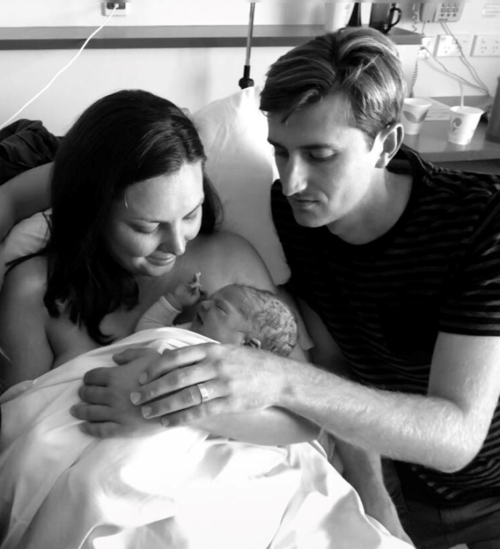
Place of Birth
The Birthplace cohort study Birthplace in England Collaborative Group 2011
Midwifery Units appear to be safe for baby and offer benefits for mother
For planned births in freestanding midwifery units and alongside midwifery there were no significant difference in adverse perinatal outcomes compared with planned birth in an obstetric unit.
The results support a policy of offering healthy women with low risk pregnancies a choice of birth setting. Women planning birth in a midwifery unit and multiparous women planning birth at home experience fewer interventions than those planning birth in an obstetric unit with no impact on perinatal outcomes. For nulliparous women, planned home births also have fewer interventions but have poorer perinatal outcomes for primiparous women.
Outcomes women commenced labour at Birthcare
SVB | 86.9%
Operative Birth | 8.2%
LSCS | 4.8%
Baby to NICU | 1.4%
Excl. BF on Discharge | 90.9%
Notes:
Encouraging low risk women to birth in a primary environment will reduce unnecessary interventions without compromising perinatal outcomes, the evidence tells us this. yet in 2018 only 275 women birthed at birthcare. We know that intervention rates are also lower for women who commence their labours in a primary unit even if they are transferred in labour so there are benefits even if transfer is required and there are no negative impact on perinatal outcomes. If we look at the birthcare data of the 352 women who commenced labour at birthcare 22% had a caesarean section. The exclusive breastfeeding rate was 92% in the group of women who birthed at birthcare and 85.7% for those transferred in labour both significantly higher than the rates we see for women who birth at NWH.
The Outcomes above show the overall rates achieved for women who commenced their labour at birthcare.
Birthcare clearly has much more capacity for births and provided postnatal stays for 3629 women last year.
Contributing to the low numbers of women accessing Birthcare is the fact that only 1/3 of women have a midwife LMC and those accessing private Obstetricians and the community team do not currently access the primary birthing unit. So even if every low risk person from that cohort commenced labour in a primary unit the numbers would be limited. (removing homebirth women, 1\3 of that group would be around 800 women. This is however significantly more than the 354 who commenced their labours there in 2018.
There are women in both the DHB community midwife and the Obstetrician LMC groups who would potentially benefit from commencing their labours in a primary unit.
Again we see the woman’s choice of provider having a significant impact on her choices and her outcomes.

Slide 27
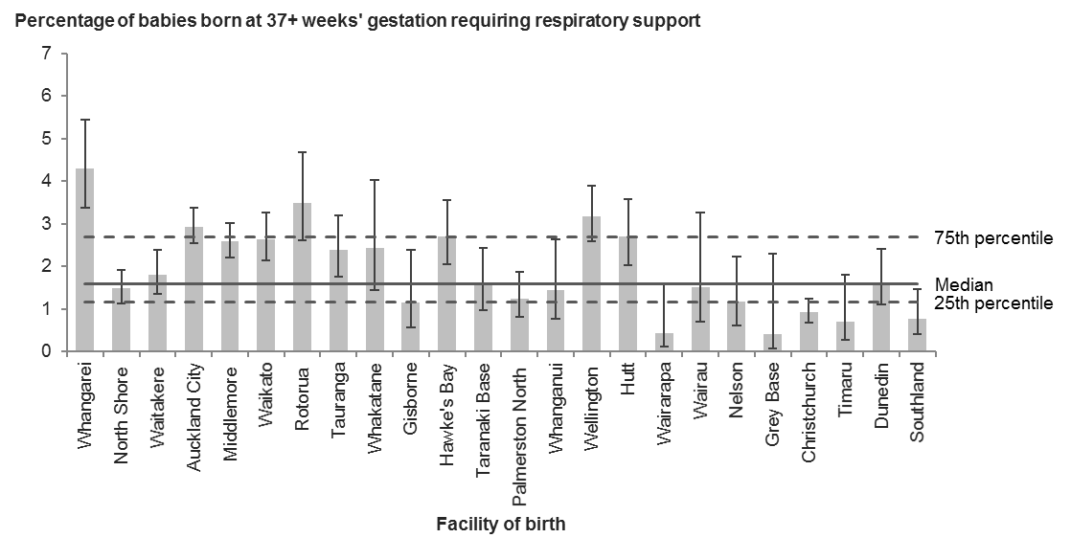
Term babies to NICU requiring more than 4 hours respiratory support
National Maternity Clinical indicators 2017
National indicator data 2017
Notes:
So I thought I should look at perinatal outcomes and it is a bit unfair to start with this page but this is the data from the national indicators. We are an outlier on this indicator with above usual rates of admission to NICU for more than 4 hours of respiratory support.
We have seen this rate gently rise over the last 7 years so it is an area we need to look at going forward.
Generally speaking our perinatal outcomes however are good with low rates of NE and fetal loss compared to national numbers.

Slide 28
Notes:
Our data fields do identify an increased risk of low apgar and admission to NICU for women induced and having an elective LSCS compared to those who commence labour spontaneously however of course the spontaneous labour group should be lower risk women. I guess it would be interesting to know if they in fact are because we know that there are many low risk women who are in the intervention groups. But that is a question for further audit and research.
I thought the second table might be a bit more interesting in terms of seeing trends but actually rates of low apgars, admissions to NICU and >2 day stays have not changed appreciably over the years. I guess it is interesting that despite an increase in interventions across the board over that time outcomes have not really changed.

Slide 29
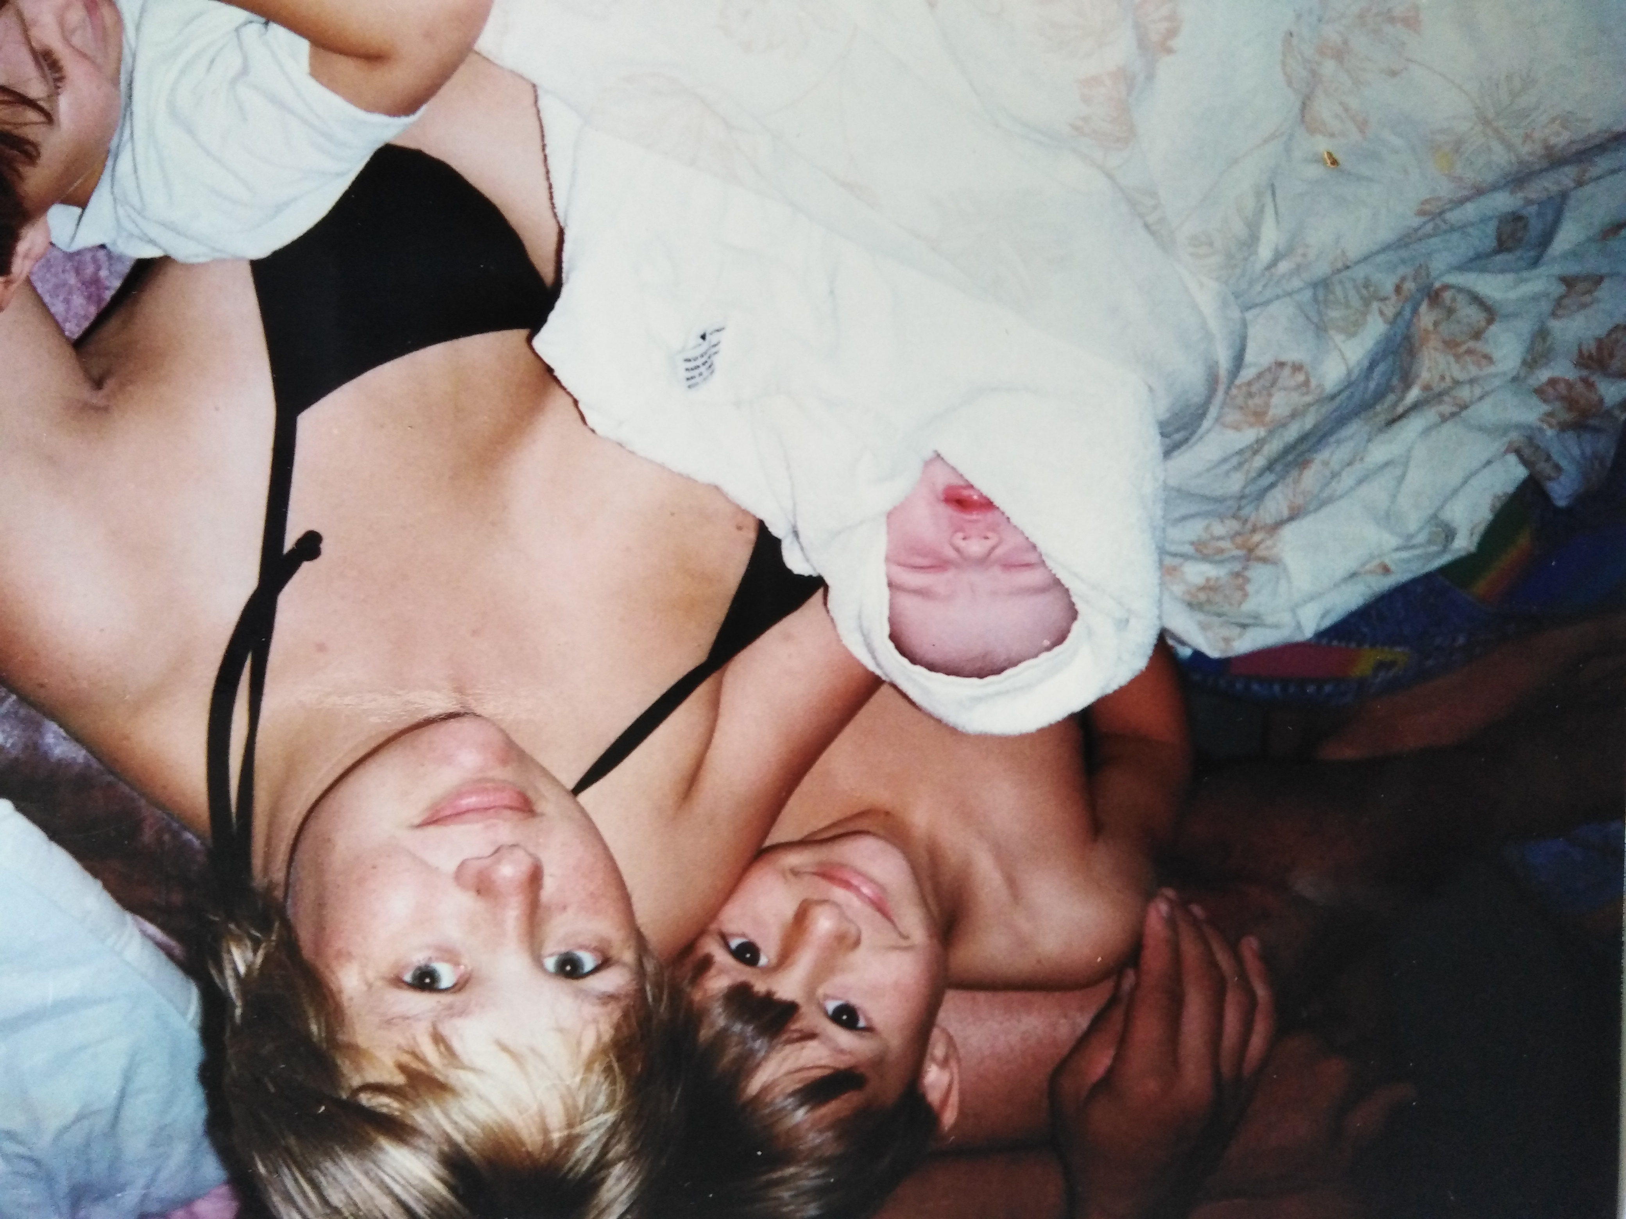
In Conclusion
5. Are we setting our Mama’s babies and families on the right path forward?
1. Who are we? What is our purpose?
Do we meet the cultural needs of every woman and her whanau?
4. Should we look to reduce the rates of intervention? Can we?
2. Is it OK that provider type has such a significant impact on their outcomes? - What is choice?
3. Are we certain we are giving women complete information with which to make a decision every time – Are we aware of our own bias and how we present that?
6. What is choice?
Notes:
So I hope I haven’t bored you all too much, I know some of these slides are a bit heavy duty, but I guess working through the document and looking at the context within which we provide care here has been an interesting process.
Coming here I keep hearing things like, “intervention is fine”, “it is what women want”. “It is all about choice”. “Our neonatal outcomes are good so no issues”
Why do women in Auckland make such different choices to women in other areas of the country? Are we somehow responsible for encouraging the choices they make in any environment? If we are driving choice are we doing so with those mothers, babies and families at the very forefront of those choices and are we fully considering the separation of mothers and babies, impact on breastfeeding and on-going health throughout the life cycle. Do future babies come into our consideration.
And 5 As midwives are we confident we know what our fundamental ethics are around provision of care and promotion and protection of the physiological process of pregnancy, labour, birth and breastfeeding? We have to be able to practice our craft with women in the environment most suited to women’s need so as to ensure she is uninhibited by her surroundings. We need primary birthing options to be available and accessible and to enable and encourage access to them for low risk women. Interventions are designed to be used when necessary – we can support women to understand when they are necessary and the risks of intervening are outweighed by the risks of not. We have a responsibility to do this.
And 3When women are being given information we need to be clear what our own inherent bias is so that we can be really sure we offer the full range of choices and information that woman needs to make her choices. That her cultural needs are clear and her cultural practices enabled. Why does it make a difference who her provider is as to what care she has access to and where? Is that reasonable?
4. Should we look to reduce intervention? Well clearly I think so. There doesn’t seem to be any advantage in undertaking intervention from baby’s perspective in low risk situations and there are significant risks to mum and future babies. We can support women to birth without heaps of intervention but it takes time and it takes expert support. Women should not be afraid of birth and neither should practitioners be afraid to support them.
6. What is choice? Choice is a hugely complex thing. Its not easy to ensure choice is actually informed
Women of course should be able to choose their maternity care provider. But in a perfect world, regardless of who that carer is and what training he or she has had, each woman would access the care and intervention she needed, within the cultural paradigm correct for her and in the right place for the level of care she requires.
We could achieve these outcomes, but we need to decide on a path forward and do it together as professions and with women and whanau taking the journey with us.

