Slide 1
Auckland Annual Clinical report Presentation Day
Patrick J Keating
Gynaecology Oncology SMO
Wellington Regional Hospital

Slide 2
MDM metrics
1,106 new referrals (1,086 met criteria)
  2,386 discussions
  Ratio 2.19 discussions per patient
  Despite a widening gap between discussions and patient numbers this ratio is good.
  Suggests adequate information is available at the MDM
    90% women discussed within 14 days
  Drop in non Gynae Cancer discussions

Slide 3
Staffing
Gyn Onc SMO | 5 (4.2 FTE)
Med Onc | 3
Rad Onc | 3
Pathologists | 4
Radiologists | 3
Sp Nurses | 2 + 1
MDM coordinators | 1.6
GO Fellow | 1
UK recommendation is
  3 x Gyn Onc per million
  ☞ 7 Gyn Onc SMO’s
Wellington has
  2.6 Gyn Onc per 1 million

Slide 4
Faster Cancer Treatment
Ministry of Health targets
  73% in 2016
  83% in 2017
  91% in 2018…congratulations
Gynae Oncol MDM
  The only one functioning 52 weeks of the year

Slide 5
Faster Cancer Treatment
Patients are seen the day after the MDM
  2015 – 3.2%
  2016 – 27.1%
  2017 – 49.6%
  2018 – 53.1%, and 73.1% within one week
Scheduling for IDS
  DOH 31 day target – 70% in 2016, up to 90%

Slide 6
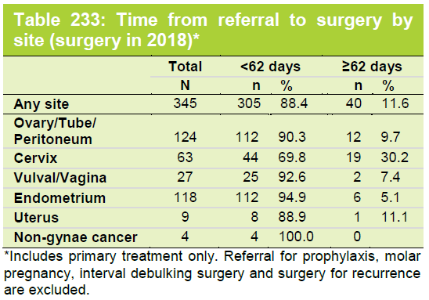
Faster Cancer Treatment
Cervix cancer are taking longer to get to theatre
  EUA might contribute.
  Why EUA?
ESGO 2018 guidelines
Mandatory initial workup for assessment of pelvic tumor extent and to guide treatment options is pelvic magnetic resonance imaging (MRI) (grade B). Endovaginal/transrectal ultrasound is an option if performed by a properly trained sonographer.
Cystoscopy or rectoscopy may be considered to provide a biopsy if suspicious lesions in the urinary bladder or rectum are documented on MRI or ultrasound.

Slide 7
Gynaecologic Oncology Surgeries
Increase in surgical activity by 11%
  Really?
  What happened to those cancers before?
More Consultant FTE’s…..
  Proportion of Malignant to Benign/PreMalignant has INCREASED
Is something else going on?

Slide 8
Minimal access Surgery
69% endometrial cancers treated laparoscopically.
  In 2017 it was 30%
  Excellent
  ESGO Recommendation 4:10 supports this
Sign QPIs (2018)
  Set the bar at 70%
LACC trial – we would agree with you!
  See recent BGCS paper – size of tumour

Slide 9
Ovarian Cancer debulking
Primary surgery, 60% (2017) up to 69%
  R0 resections 84% (2017) 88%
IDS
  51% R0 resection
  88% les than 10mm resection
Recurrence surgery
  R0 resection achieved 83%

Slide 10
At what price?
Complications
  Readmission rate;
    2017 – 8.6%
    2018 – 5.4%
  Benign gynaecology readmission after TAH – 12%
Overall complications rates are comparable.
Increase in blood loss/transfusion
  8.6% to 12.8%...possibly the ovarian surgical extent?

Slide 11
Other stuff.
Strategy day - visioning
Research
  International presentations
  Collaboration – FeMMe trial, EXCISE
Audit
MMR testing streamlined.

Slide 12
What was I looking for...?
Staffing and resources
Caseload / Case mix
Waiting times
MDM performance
  Ratio of discussions to patients
  Core attendance
Treatment details
  Enhanced recovery programme
    LOS MIS 1-2 days, open 3-4 days
  Proportion of primary vs IDS resections
  Proportion Laparoscopic surgeries
  Proportion Sentinel Groin nodes

Slide 13
What else was I looking for...?
Outcome data
  Complications / readmissions
  R0 resections (ovarian/fallopian cancer)
  Long term data and survival
Patient Information – up to date
Genetic testing
  HGSC
  MMR
Risk reduction – RRSO / Hysterectomy
Guidelines update
Specialist Nurse resource
  Holistic needs assessments
Research & publications
Audit

Slide 14
Colposcopy
C-Quip have not set numerical standards
  Makes it difficult to bench-mark
Overall falling numbers of cases
  Possible effects of HPV vaccination

Slide 15
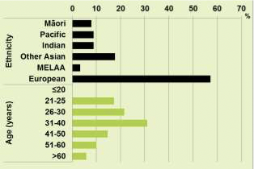
Colposcopy
Can the proportions be compared with the proportions within your community?

Slide 16
NCSP guidelines
No referrals under 20 years of age
  Possibly more a reflection of primary care?
Smoking status
  13% smoke free
No mention of HIV testing
  No mention in NZ guidelines (as far as I can see)
  UK National guidelines for HIV testing
    Vaginal intraepithelial neoplasia
    Cervical intraepithelial neoplasia Grade 2 or above

Slide 17
Colposcopy accreditation
18 colposcopists
  Sufficient for 64 cases per year
No mention of the C-QuIP requirements for accreditation
  How many of the 18 are up-to-date?
For example
  Less than 95% of HSIL have a biopsy
    Do you have any outliers?
  Possible audit…?
Training in colposcopy
  How many have completed?

Slide 18
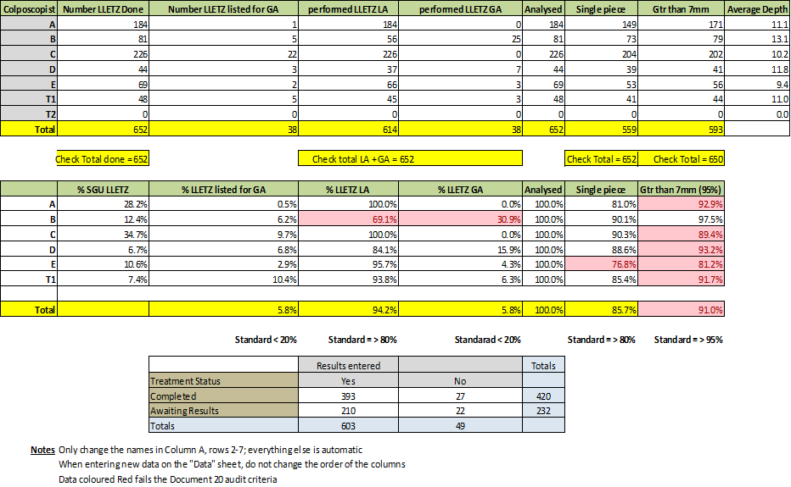
2016 Royal Preston Hospital Audit data

Slide 19
Treatments
All are excisional
  LLETZ 92.6%
  Cold knife 4.8%......why?
77% LLETZ under local anaesthesia
  Target is 80%
  This might be worth an audit.

Slide 20
Research & Training
PRINCESS study
EXCISE study
Self sampling study
Registrar training
  Numbers?

