Slide 1
ACR – Neonatal
Assoc Professor Nicola Austin
CDHB

Slide 2
Overview
SURPRISES
Term Admissions
Near term admissions
Very preterm morbidity
Outcomes

Slide 3
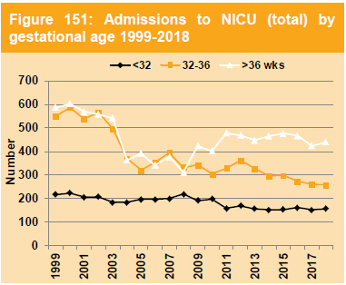
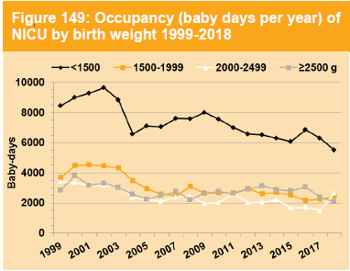
Surprises
Lower admissions 2017/18 and occupancy 93%
852 in 2018 - counted if stay over midnight

Slide 4
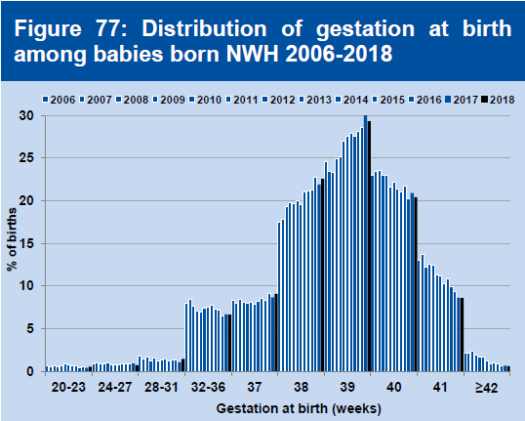
Term admissions
Drivers ……. Look in the labour and birth section
Timing

Slide 5
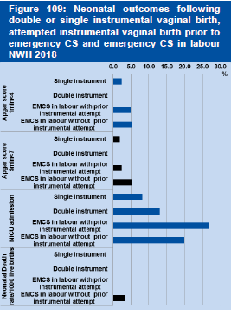
Term admissions
Drivers ……. Look in the labour and birth section
Type of delivery
Emergency caesarean (n=793)
for fetal distress 25.3%
and obstructed labour 53.2%

Slide 6
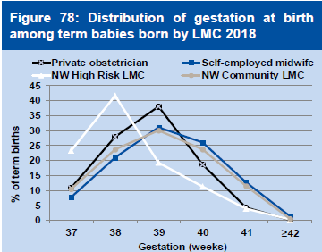
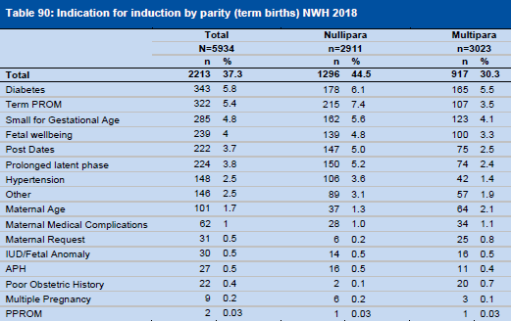
Term admissions
Drivers ……. Look in the labour and birth section
Acuity ? Reason for induction

Slide 7
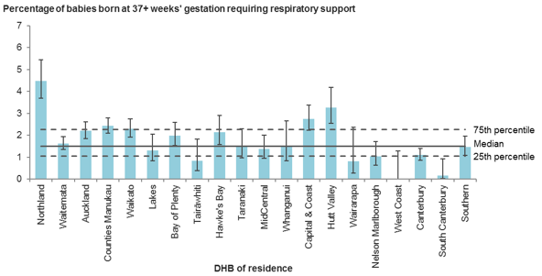
ACR data compared with Clinical indicator 20

Slide 8
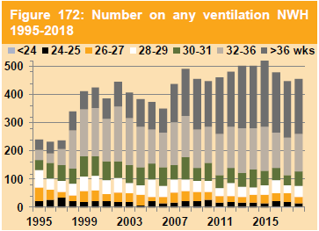
Near term admissions

Slide 9
What about the term and near term cared for on the postnatal ward?
Transitional care …….. No data
New categoury in Neonatal service specification for ratification
35/36 wk in NICU 99+8=107, PN =197

Slide 10
Very preterm morbidity - Prevention

Slide 11
Very preterm morbidity
Respiratory support
Chronic Lung Disease
Retinopathy
Intraventricular Haemorrhage
Sepsis
Feeding
Neurodevelopmental Outcome

Slide 12
Very preterm morbidity Respiratory support

Slide 13
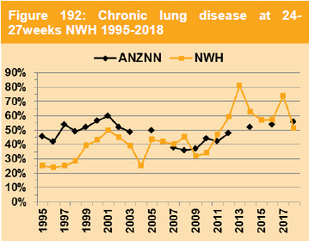
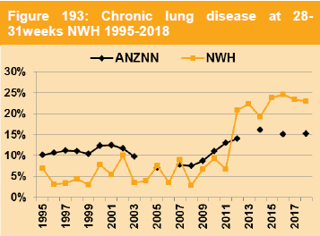
Very preterm morbidity Chronic lung disease

Slide 14
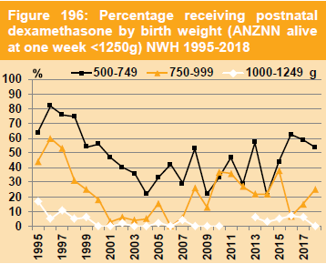
CLD – management

Slide 15
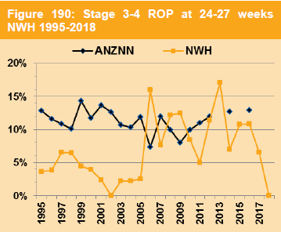
Very preterm morbidity Reduced Retinopathy and Intraventricular Haemorrhage
1

Slide 16
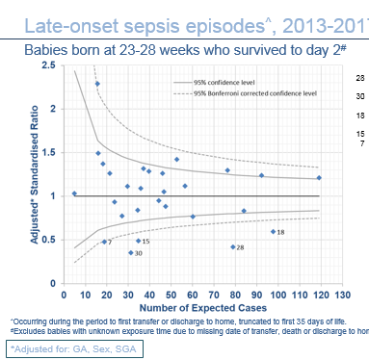
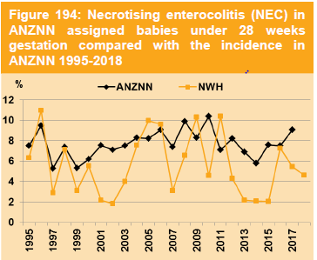
Very preterm morbidity Infection
10 Early onset – Gp B Strep 4, E coli 4 (30-34w)
7 CLABBSI / 25 Late onset sepsis
Coagulase negative staphylococci 4 / 8
NEC reduced since probiotics in 2011
7

Slide 17
Feeding at discharge from NICU

Slide 18
Neonatal outcome

Slide 19
Conclusion
Large range of data and outcomes
Drivers of neonatal admissions
Missing data on transitional care babies on PN
Ka pai
Questions

