Slide 1
Audit of Hypoglycaemia Screening on the Postnatal Wards
Pascell M, Alsweiler JM

Slide 2
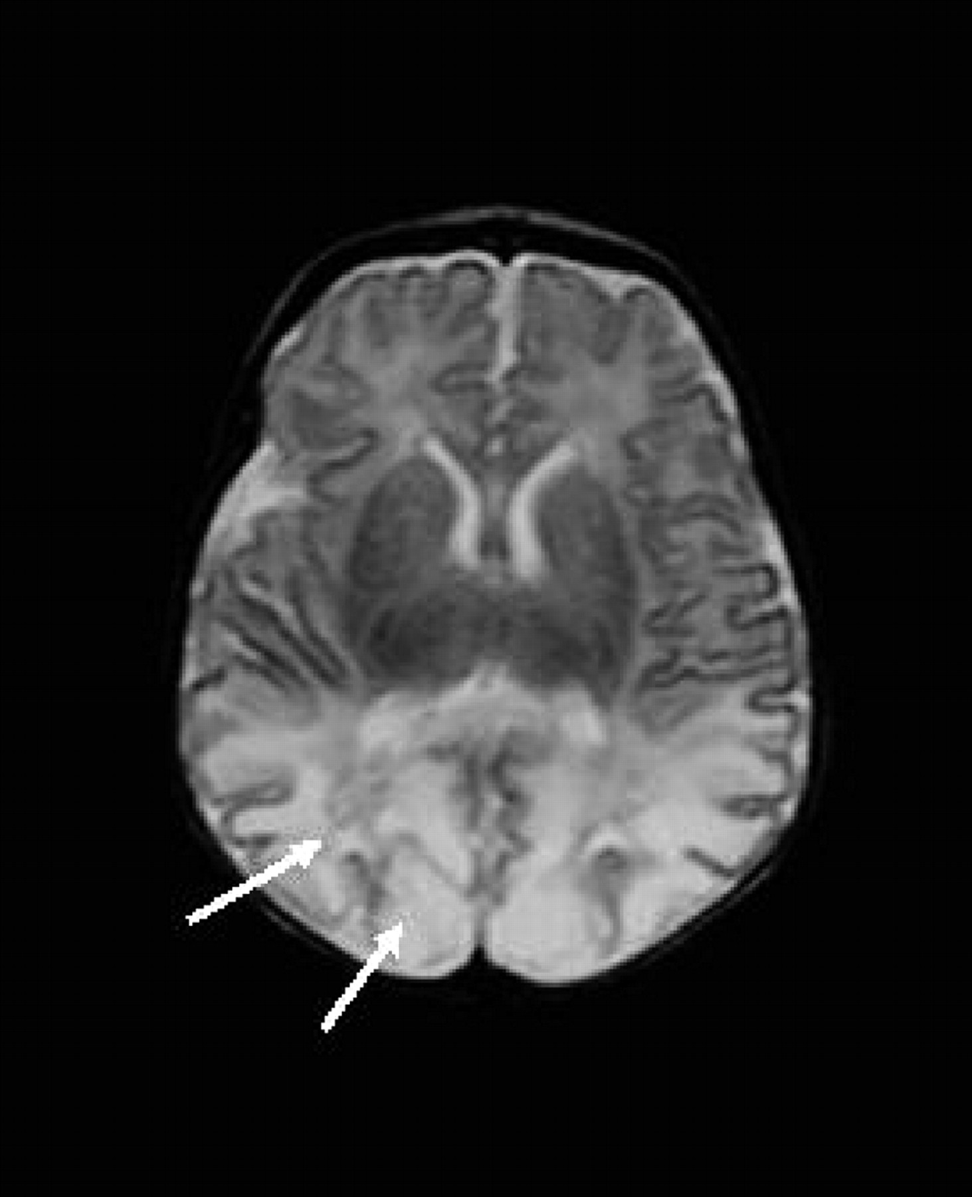
Hypoglycaemia causes brain damage
Burns C M et al. Pediatrics 2008;122:65-74
©2008 by American Academy of Pediatrics
Notes:
Term baby with symptomatic hypoglycaemia
Posterior WM abnormality (T2-weighted MRI scan in the transverse plane obtained 14 days after birth; GA: 39.71 weeks). There is severely abnormally high SI with loss of gray matter/WM differentiation bilaterally in the posterior parietal and occipital lobes (arrows). Appearances within the BGT and PLIC are normal. This child developed cognitive delay, epilepsy, and impaired vision.

Slide 3
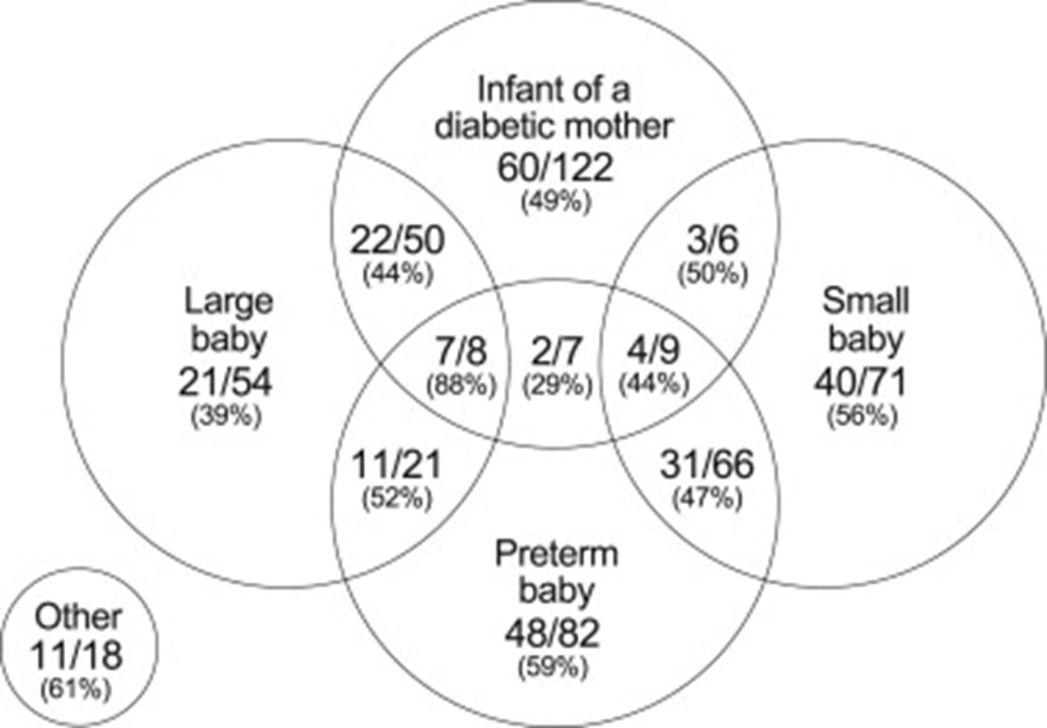

Slide 4
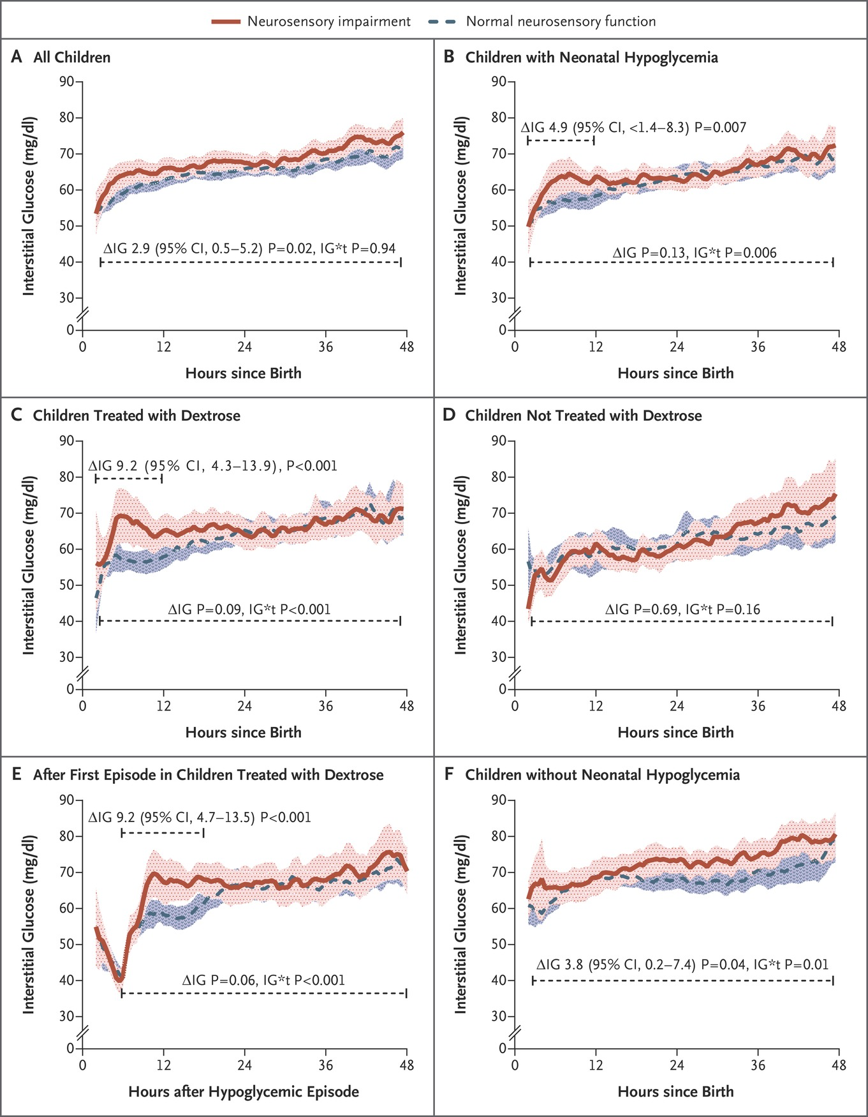
McKinlay CJD et al. N Engl J Med 2015;373:1507-1518
Notes:
Figure 3 Results of Interstitial Glucose Monitoring in Children with and Those without Neurosensory Disability at 2 Years. Data are means and 95% confidence intervals and represent the per-child 0.5-hour average of continuous interstitial glucose concentrations. ∆IG denotes the mean difference in the first 12 hours or first 48 hours, as determined from repeated-measures analysis, and IG*t the group–time interaction. Panel A shows data for all 302 children who underwent interstitial monitoring in the first 48 hours after birth, Panel B shows data for the 162 children with neonatal hypoglycemia, Panel C shows data for the 104 children with neonatal hypoglycemia who were treated with dextrose (buccal dextrose gel, intravenous dextrose, or both), Panel D shows data for the 58 children with neonatal hypoglycemia who were not treated with dextrose, Panel E shows interstitial glucose values after the first hypoglycemic episode in the 104 children treated with dextrose, and Panel F shows data for the 140 children without neonatal hypoglycemia.

Slide 5
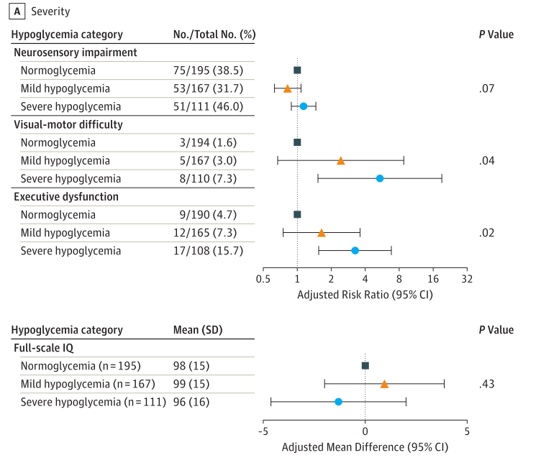

Slide 6
Notes:
As a reminder, the NWH guidelines state………..

Slide 7
Notes:
As a reminder, the NWH guidelines state………..

Slide 8
Aims
Primary aim:
To determine adherence to the guideline for hypoglycaemia screening.
Secondary aim:
To determine adherence to the guideline for treatment of hypoglycaemia.
Notes:
Define screening adherence, define treatment adherence

Slide 9
Methods
Following AHREC approval, a list of all births at ACH in 2018 was generated from the maternity database.
ahrp.org

Slide 10
Methods
Inclusion criteria:
At least one risk factor for hypoglycaemia
Exclusion criteria:
Non-viable neonates
NICU admission prior to screening

Slide 11
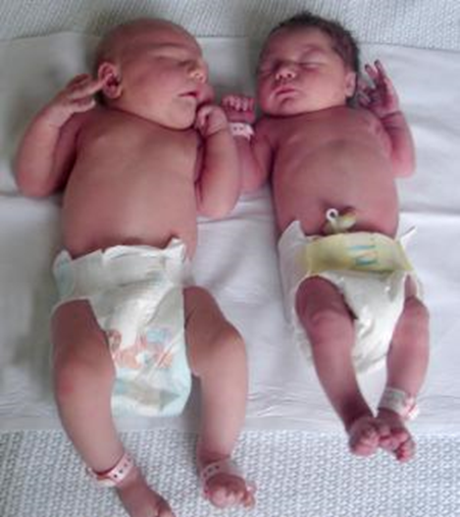
Methods
Random selection and chart review of 50 patients from each at-risk group.
Notes:
If more than one risk factor…..

Slide 12
Definitions
Screened – any BGC 48 hours after birth
Adherence to Screening
Screened AND
First BGC 1-2 hours after birth AND
3 consecutive BGC >2.5 mM
Adherence to Treatment
- Dextrose gel prescribed and given
- BGC 30 min after gel

Slide 13
2011
2015
2018
Liveborn viable babies N= 7570
Liveborn viable babies N= 7004
Liveborn viable babies N= 6532
<36/40 N= 458
<2200g N= 324
NICU N=832
<36/40 N= 413
<2200g N= 324
NICU N= 832
<36/40 N= 374
<2200g N= 307
NICU N= 742
Eligible babies
N=6637
Eligible babies
N=6090
Eligible babies
N=5697
IDM N= 789
Preterm N= 151
SGA N= 683
LGA N= 439
IDM N= 633
Preterm N= 139
SGA N= 810
LGA N= 393
IDM N= 666
Preterm N= 134
SGA N= 693
LGA N= 254
Notes:
2018
Total 6597 – stillbirth 57

Slide 14
Baseline
 | 2011 N=200 | 2015 N=200 | 2018 N=200
Maternal Age (years) | 31.8 (5.4) | 33 (5.2) | 32 (4.9)
Maternal BMI | 24 (21-30) | 25 (19-29) | 25 (22-31)
Birth Weight (g) | 3330 (727) | 3319 (733) | 3332 (772)
GA (weeks) | 38 (36-39) | 38 (36-39) | 38 (36-39)
Male | 55% | 48% | 52%
Ethnicity
Māori | 19 (10) | 21 (11) | 20 (10)
Pacific | 32 (16) | 27 (14) | 27 (13)
Asian | 59 (30) | 63 (32) | 82 (41)
NZ European | 86 (43) | 79 (40) | 63 (31)
Other | 4 (2) | 10 (5) | 8 (4)

Slide 21
Treatment
62/200 (31%) Hypoglycaemic
66% prescribed and given dextrose gel
76% BGC re-checked within time frame
Overall 50% of treatment adherent
Re-testing on Accu-chek
Notes:
“Rechecked” – 10 = 5%

Slide 23
Discussion
Screening adherence improving
Treatment adherence needs improvement
BMS volume
Harris DL et al. J Pediatr. 2017;11:11.

Slide 24
