Slide 1
Outcome of pregnancies ending at 20-25 weeks' gestation from 1995 to 2018
David Knight
Lynn Sadler
Katie Groom
Janice Taylor
Newborn Services, Women’s Health & Child Development Unit

Slide 2
Aim and method
Document outcome of all pregnancies presenting to NWH/ACH at <26 weeks gestation when fetus was alive on maternal admission, from 1995 to 2018
Data from maternity Healthware and Neonatal databases
Follow-up to 2 - 4 years by Newborn Services Child Development Unit
Data checked from maternal and paediatric notes
Study approved by Auckland Health Research Ethics Committee

Slide 3
Survival to 28 days of very preterm babies by hospital of birth 2007-2016
Gestational age
PMMRC report 2018

Slide 4
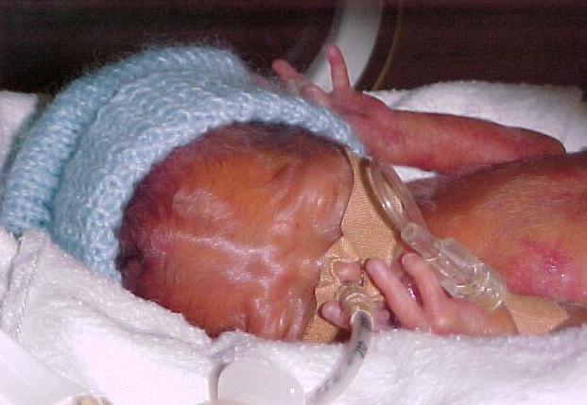
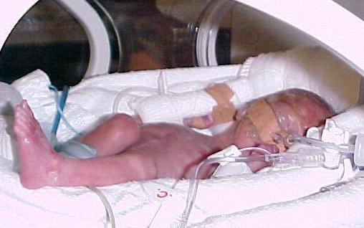
Caleb
23⁵ weeks
650 gm
Ashleigh
23⁵ weeks
610 gm

Slide 5
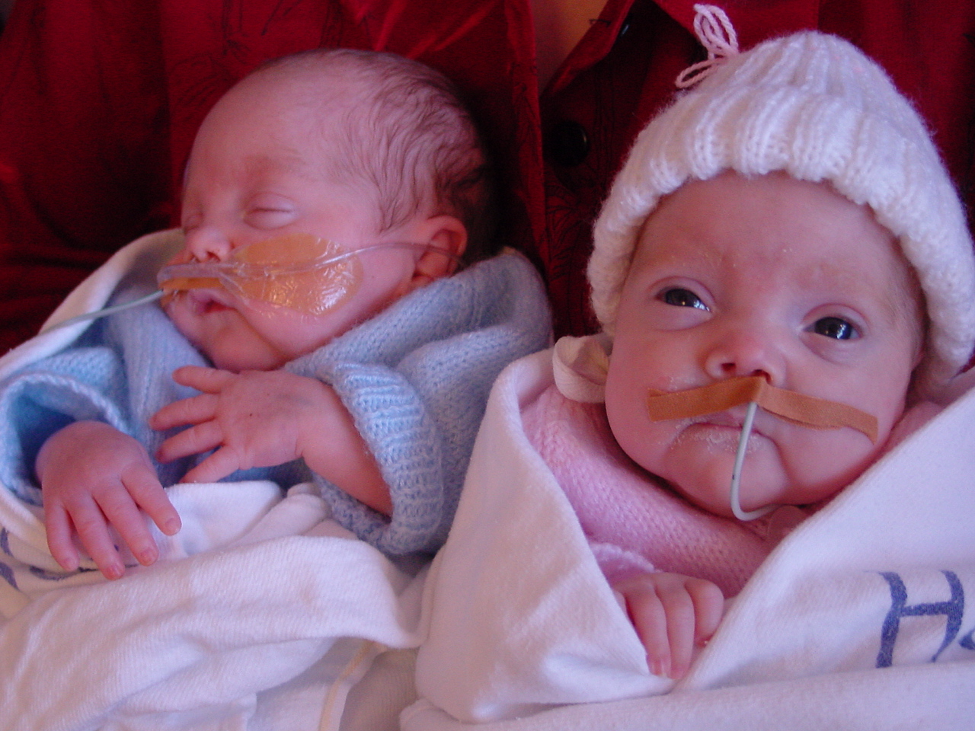
Caleb and Ashleigh at 36 weeks gestation,
2 days before transfer to Gisborne

Slide 6
Neurodevelopmental outcome Child Development Unit, NWH Modified from Kitchen et al, 1984 and 1987
Normal
Mild impairment
Tone disorder or motor delay
Bayley motor score >1SD below mean but mental score within the average range
Moderate disability
Bayley MDI 1 - 2 SD below mean
Mild-Moderate CP without developmental delay
Impaired vision needing spectacles
Severe disability
Bailey mental score ≥2SD below the mean
Severe cerebral palsy
Bilateral blindness
Sensorineural deafness needing aids

Slide 7
Births at 20-25 weeks gestation in NWH, 1995-2018 n = 1877
260 301 284 294 351 387 Number
115 143 153 174 261 315 exc Pre-lab and Malform

Slide 8
Babies born in NWH at 23 weeks from 1995-2018

Slide 9
Outcome of babies born at 23 weeks from 1995-2018

Slide 10
Outcome of babies born at 23 weeks from 1995-2018

Slide 11
Outcome of babies born at 23 weeks from 1995-2018

Slide 12
Outcome and birth weight of babies at 23 weeks gestation

Slide 13
Outcome and 1 minute APGAR score of babies at 23 weeks gestation

Slide 14
Resuscitation and survival at 23 weeks gestation

Slide 15
Babies born in NWH at 24 weeks from 1995-2018

Slide 16
Outcome of babies born at 24 weeks from 1995-2018

Slide 17
Outcome of babies born at 24 weeks from 1995-2018

Slide 18
Outcome of babies born at 25 weeks from 1995-2018

Slide 19
Survival to discharge home
 | Alive at onset of labour | Alive at birth | Admitted to NICU
23 weeks | 13% | 21% | 45%
24 weeks | 55% | 63% | 70%
25 weeks | 76% | 79% | 81%
26 weeks | 88% | 91% | 92%
27 weeks | 94% | 94% | 96%

Slide 20
Long term outcome of survivors
 | Normal | Mild | Moderate | Severe | Died
23 weeks | 55% | 5% | 20% | 15% | 1%
24 weeks | 57% | 11% | 19% | 12% | 0
25 weeks | 62% | 13% | 14% | 9% | 2%
26 weeks | 82% | 4% | 12% | 1% | 0
27 weeks | 85% | 2% | 8% | 4% | 1%

Slide 21
Survival and neuro-developmental injury in actively treated babies: international comparisons
Isayama T, Translational Pediatrics, 2019; 8:199-211
Sharp M, J Paed Child Health 2018; 54:188-193

Slide 22
Conclusion
Long-term outcomes of babies born 23 to 25 weeks gestation comparable to international results
Outcomes of babies admitted to NICU at 23 weeks similar to 24 weeks
At 23 weeks gestation, majority of deaths used to be in labour or in those not resuscitated
Results have improved. At 23 weeks gestation, counselling parents is now more positive
Almost all parents request active treatment
Almost all babies are actively treated
The majority of those who survive are normal developmentally

Slide 23
Caleb
23⁵ weeks
650 gm
Ashleigh
23⁵ weeks
610 gm

Slide 24
Aged 18
Ashleigh
Caleb

Slide 25
Survival to discharge of babies admitted to NICU

Slide 26
France, NZ and NWH: Comparison of survival of all live-births
 | France 2011 | NZ 2007-2016 | NWH 1995-2018
23 weeks | 1% | 30% | 21%
24 weeks | 31% | 70% | 63%
25 weeks | 59% | 85% | 79%
26 weeks | 75% | 91% | 91%
27 weeks | 82% |  | 94%
Ancel PY et al. Survival and morbidity of preterm children born at 22 through 34 weeks' gestation in France in 2011: results of the EPIPAGE-2 cohort study. JAMA Pediatr 2015; 169: 230-238
NZ PMMRC Report 2018 (NZ: Survival to 28 days. France and NWHZ: survival to discharge home)

Slide 27
Changes over time for 23 week babies
Survival if admitted to NICU
1995 – 2004: 11 of 31 = 35%
2005 – 2018: 12 of 20 = 60%
If alive at onset of labour
 | Fetal deaths in labour | Active treatment if born alive
1995 - 2015 | 60 40% | 46/98 47%
2016 - 2018 | 2 12% | 13/14 93%

