Slide 4
The REAL Sex Talk – Consent
https://www.youtube.com/watch?v=u-H_gBJtW9M

Slide 6
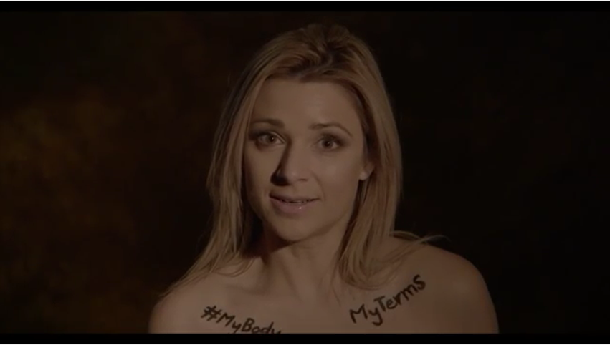
My Body, my terms
https://www.youtube.com/watch?v=XlxvLzlyJJI

