Slide 1
The Biology of Adolescence
National Women’s Health
Annual Clinical Report Day
10 August 2018
Saman Moeed, FRANZCOG, IFEPAG
Paediatric & Adolescent Gynaecologist

Slide 2
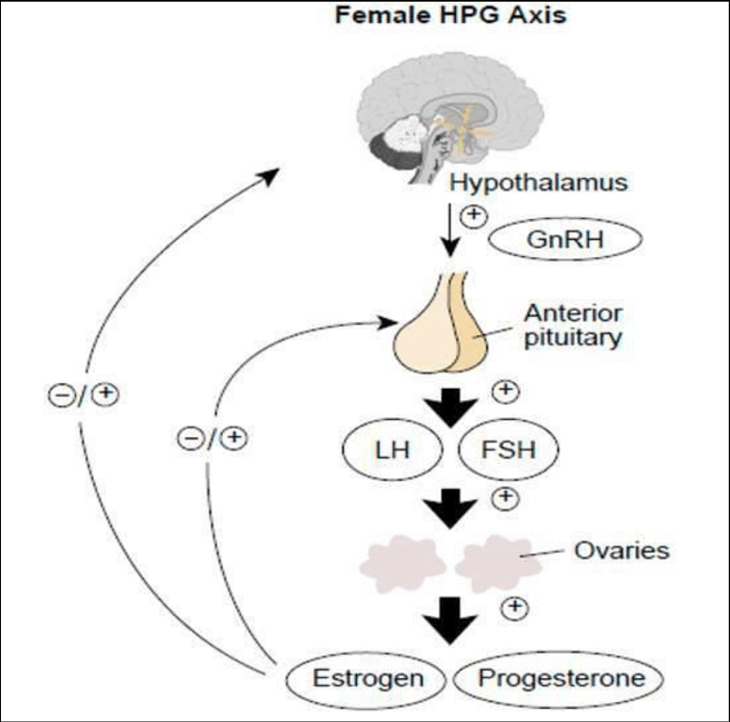

Slide 4
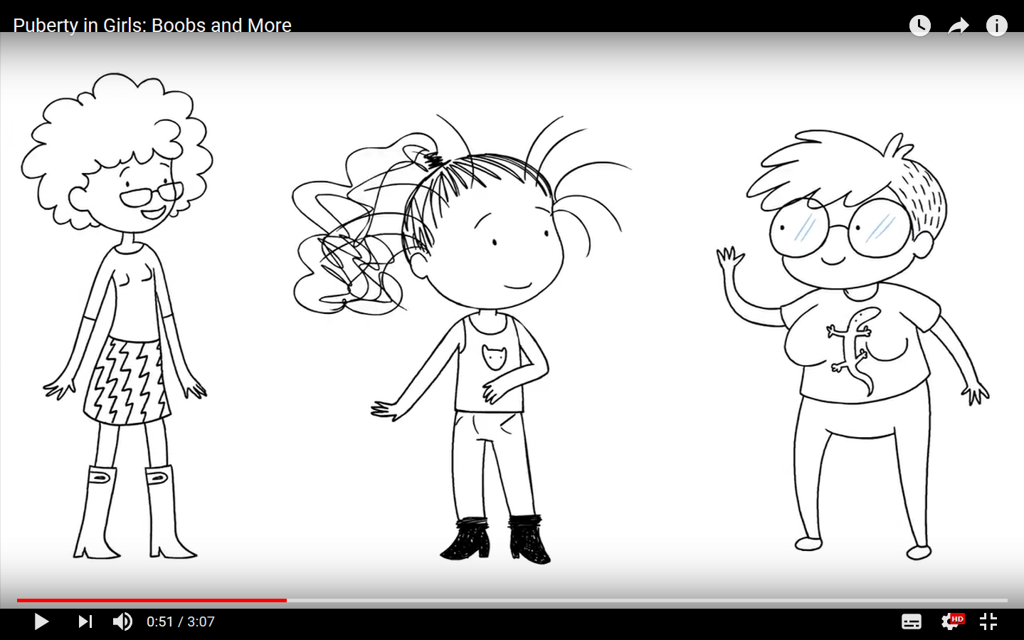
Pubery in Girls – Boobs and More https://www.youtube.com/watch?v=umpBnIxOqy8

Slide 5
Young Women’s Clinic – A Snapshot
Monthly SMO-led clinic
For women < 20 years of age
Referral conditions:
Dysmenorrhoea
Heavy menstrual bleeding
Pelvic pain
Secondary amenorrhoea
Contraception/menstrual management in complex cases
Ovarian cysts
Vulval pain

Slide 6
Age Distribution
13 14 15 16 17 18 19 20

Slide 8
Areas For Improvement
DNA rate:
14% for first appointment
Accuracy of triaging
10% of referrals outside clinic criteria
Involvement of registrars
Opportunity to share knowledge & expertise
Visiting clinicians
Audit and research
Planned registrar research project (dysmenorrhoea)

Slide 9
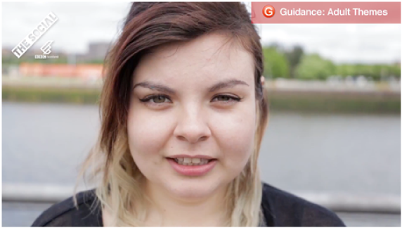
The Strength of Women – Little Girls Don’t Stay Little Girls https://www.youtube.com/watch?v=pL9NYwsWfjE

