Slide 1
Peer Sexuality Support Programme (PSSP) Education Unit of Auckland Sexual Health Service (ASHS)
Notes:
I would like to Introduce you to a programme that looks to address and deliver comprehensive sexuality education with the state school system

Slide 2
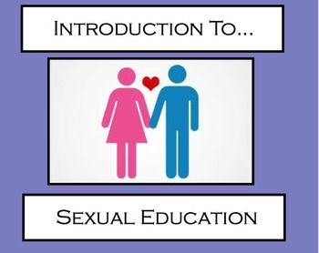
What is wrong with this image?
Notes:
Hetronormative
Follows and reinforces gender binary and associated stereotypes
Sexual education vs sexuality education (attraction/sexual orientation, gender, sex, anatomy, consent, relationships, contraception, conception, media, safe social gathering/safe partying
Associates sex with love

Slide 3
The PSSP Programme
Has been running for 24 years & trains around 120 young people each year
The Education Unit at Auckland Sexual Health Service are responsible for delivering PSSP
PSSP is established in 24 secondary schools across the wider Auckland region
It is jointly funded by the Ministry of Health & 3 regional District Health Boards
To date PSSP has trained over 2250 learners to help support and educate their peers and communities around sexual health and well being.

Slide 4
What is PSSP about?
Notes:
Creating a culture that champions young people to be better informed and empowered around their own sexual health and wellbeing.
Encourage youth to role model & sensitively support others with things that are often not easily or frequently discussed in society.
Support stakeholders to critically review school environments & take steps to celebrate diversity & inclusivity at all levels & practices.
Activily support school stake holders to engage in health promotion approaches that drive social social change then supports learning environments that are better for all.

Slide 5
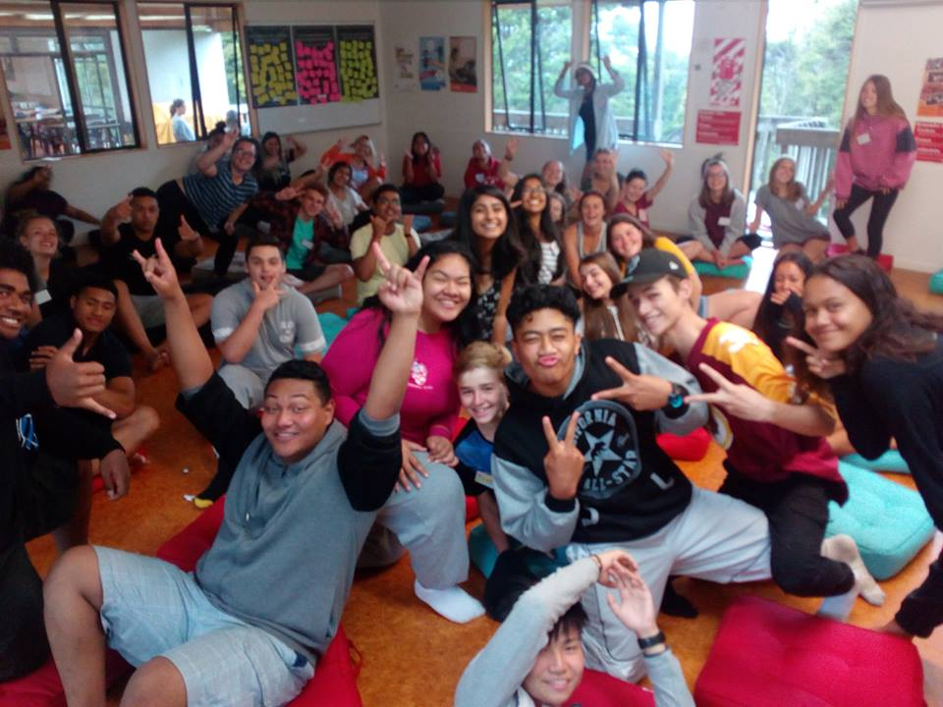
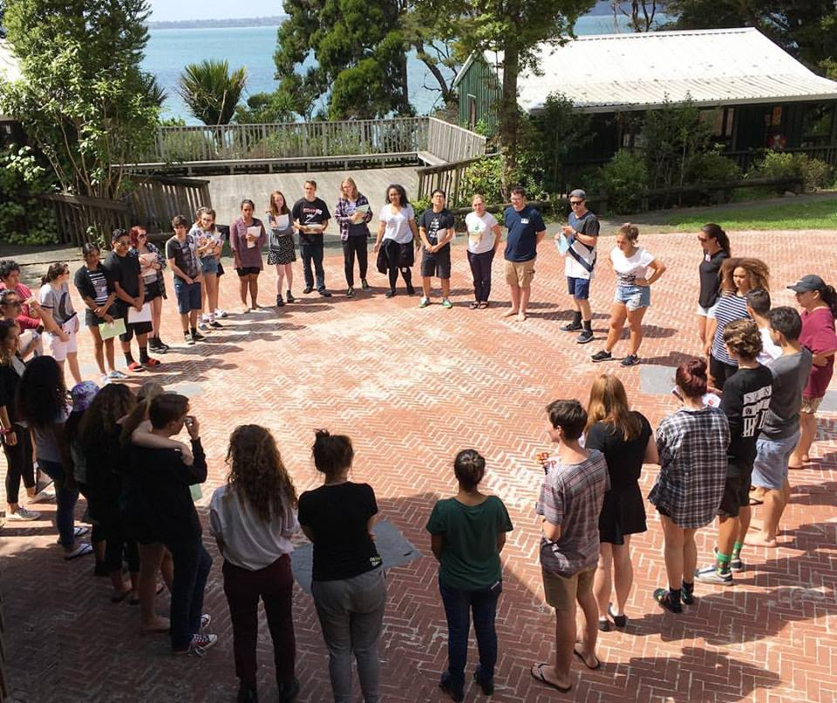
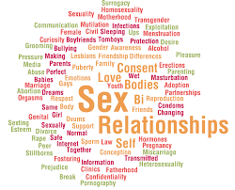
Notes:
Young people attend a 4 day residential hui

Slide 6
After PSSP Hui – What do PSSP students do?
Design and implement health promotion activities & initiatives that are community & setting specific
Support & refer contacts to safe and appropriate service providers and community resources
Work with key stakeholders to raise awareness of the need for culture change and how this could be tackled in their communities and settings

Slide 7
Current total of student recorded PSSP Contacts 2018
4228

Slide 8
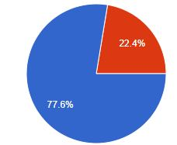
What Kind of Contacts are PSSP Leaders Having?
What do you think will be the key differences between the solo and group contacts?
Take a few moments to talk to the person next to you
Individual
Group

Slide 9
Age of Contacts
Age of Contact | Number of Contacts | % of total recorded contact
Under 13 | 27 | 0.8
13 | 81 | 2.4
14 | 114 | 3.4
15 | 522 | 15.7
16 | 955 | 28.7
17 | 785 | 23.6
18 | 137 | 4.1
18+ | 307 | 11.1
Don’t Know | 338 | 10.1
56.4% of contacts are senior school aged students?
Why is this important?
Unless they have selected health as a subject they will no longer be receiving any sexuality based education

Slide 10
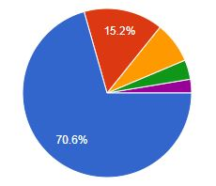
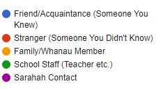
Circles of influence
43% whanau reported an increase in their young persons communication within the whanau
29% whanau reported an increase in the ability of the wider whanau to talk about sexual health & well being
Notes:
3.6% of all recoded PSSP contact identify outside of the gender binary (gender diverse, Trans male, Trans female).
This is encouraging data as it aligns with Youth 12 survey findings. Furthermore, it demonstrates that PSSP is accessible to this minority population if they choose or require its support

Slide 11
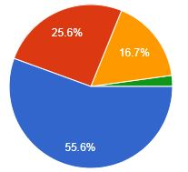
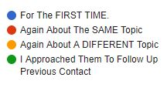
Measure of success
Volumes are one measure of success.
However, having young people continue to reengage with the PSSP leaders is the significant marker

Slide 12
Solo contacts – What gets discussed
Topic | Actual Nu / %
Relationships | 1522 / 35.2%
Sex | 735 / 17%
Mental Health | 680 / 16%
PSSP - Your service/What we do | 674 / 15.6%
Sexual orientation | 471 / 10.9%
Consent | 224 / 10.1%
Condoms | 345 / 8%
Gender | 332 / 7.7%

Slide 13
Group Contacts – What gets discussed
Topic | Actual Nu / %
Relationships | 372 / 38.5%
Sex | 335 / 34.6%
PSSP – Our service/ What we do | 332 / 34.3%
Sexual orientation | 254 / 26.3%
Gender | 239 / 24.7%
Consent | 224 / 23.2%
Condoms | 198 / 20.5%
Mental Health | 160 / 16.5%

Slide 14
Summary
Until learning institutions are fully supported & equipped to deliver comprehensive sexuality education at all levels we must continue provide other mechanisms for youth to access factual & safe resources around sexuality.
The peer to peer model works & as we see with PSSP engagement within the topic goes much further than just peers.
How can you start to introduce sexual health & well being based conversations with youth? Is relationships you door into this topic with youth?

